Slide 1
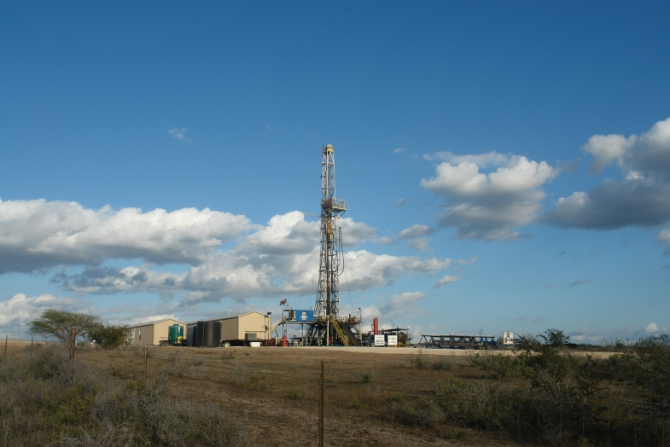
Trends and Opportunities in the Eagle Ford
Harold Hunt, PhD
Real Estate Center @ Texas A&M
College Station, Texas hhunt@tamu.edu

Slide 2
My Focus at the REC
Addressing these two questions:
How is “unconventional” drilling different from “conventional” drilling?
How long will (drilling activity in) the Eagle Ford Play last?

Slide 3
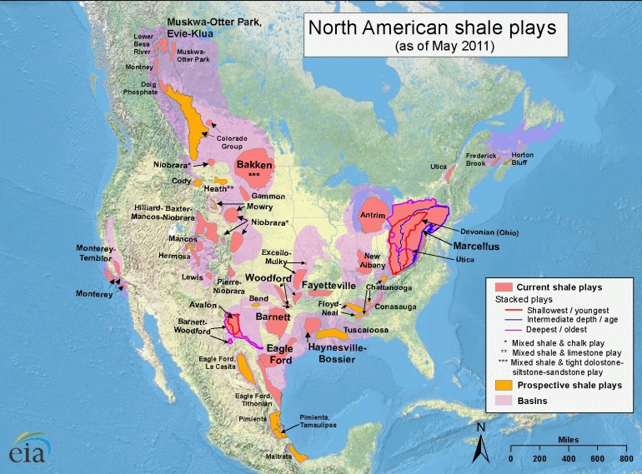
Major and Minor Shale Plays

Slide 4
Rig Counts
(Land Rigs Only as of April 25th, 2014)
Area Total Gas Oil
U.S. 1,793 305 1,488
Texas 892 85 807
Permian 542 5 537
Eagle Ford 219 9 210
Granite Wash 64 10 54
Haynesville 47 47 0
Barnett 24 13 11
Source: Baker Hughes

Slide 5
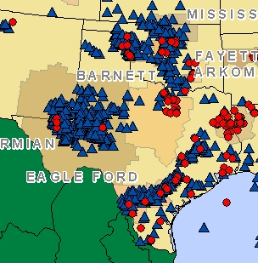
Active Drilling Rigs in Texas
(As of April 25th, 2014)
Source: Baker Hughes

Slide 6
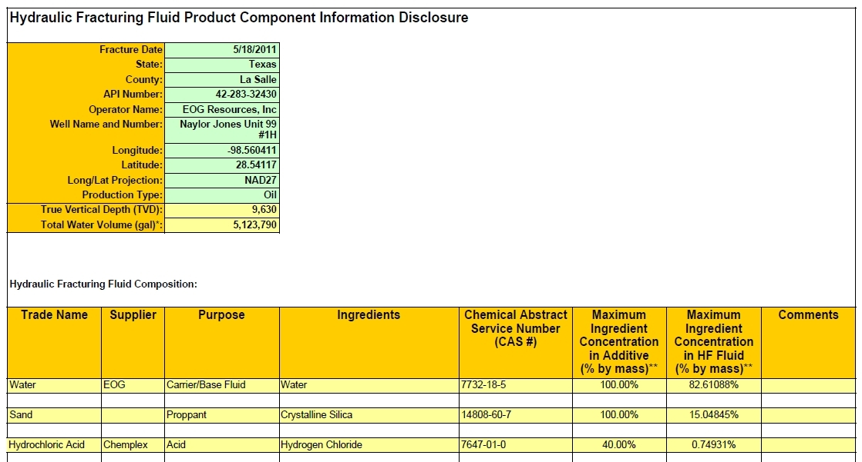
Fracfocus.org Fluid Disclosure by Well
Source: Fracfocus.org

Slide 7
Eagle Ford Shale
First Wells Drilled: 2008
Area: 20,000 sq. miles or 13 million acres

Slide 8
My Early Prediction of the Length of Eagle Ford Drilling Activity
The Dallas Federal Reserve reported that 5 mil. acres of the Eagle Ford are under lease.
So I assumed:
  4 mil. acres/200 acres drained per well = 20k total wells
  250 rigs x 5 wells drilled per yr. = 1,250 wells per yr.
  20k wells needed/1,250 wells per yr. = 16 years to drill

Slide 9
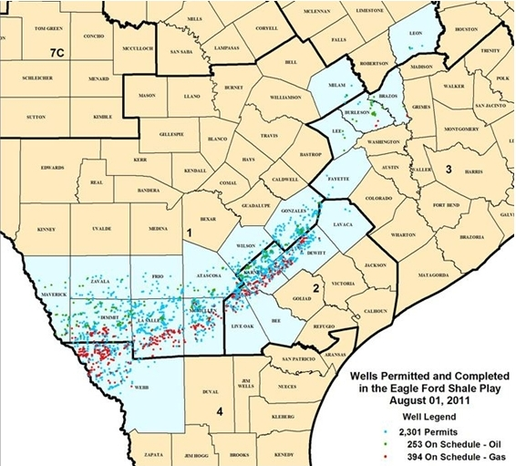
Completed Wells in the Eagle Ford
As of Aug, 2011:
263 Producing Oil Wells
394 Producing Gas Wells
Source: Texas Railroad Commission

Slide 10
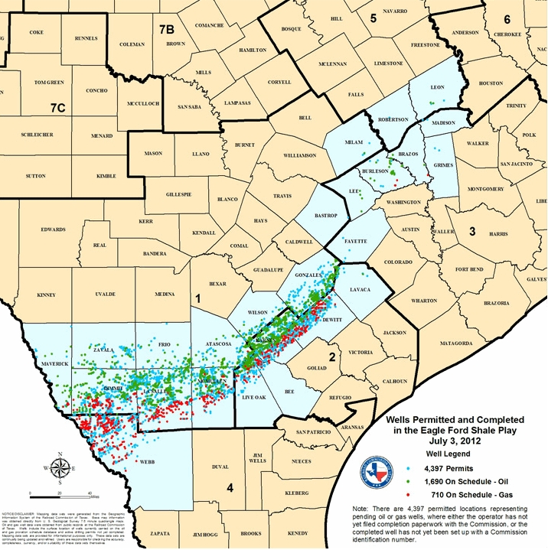
Completed Wells in the Eagle Ford
11 Months Later…
As of July, 2012:
1,690 Producing Oil Wells
710 Producing Gas Wells
An Increase of:
1,427 Producing Oil Wells
316 Producing Gas Wells
Source: Texas Railroad Commission

Slide 11
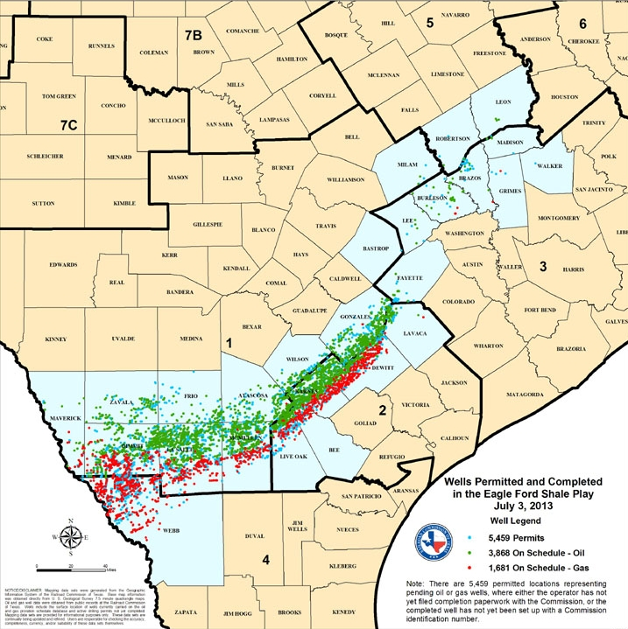
Completed Wells in the Eagle Ford
12 Months Later…
As of July, 2013:
3,868 Producing Oil Wells
1,681 Producing Gas Wells
An Increase of:
2,178 Producing Oil Wells
971 Producing Gas Wells
Source: Texas Railroad Commission

Slide 12
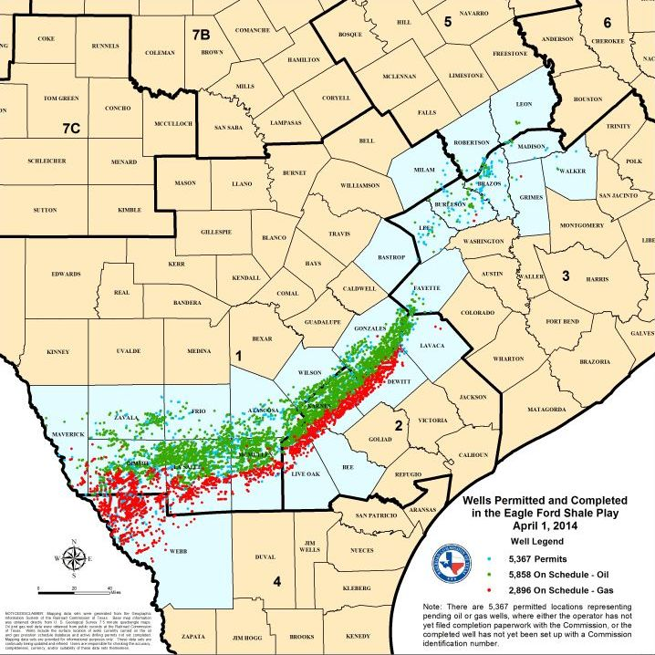
Completed Wells in the Eagle Ford
9 Months Later…
As of Apr., 2014:
5,858 Producing Oil Wells
2,896 Producing Gas Wells
An Increase of:
1,990 Producing Oil Wells
1,215 Producing Gas Wells
Source: Texas Railroad Commission

Slide 13
Several Factors Will Affect the Speed and Number of Wells that Get Drilled
Drilling one well to “hold a field by production” giving way to “pad drilling” where multiple wells are drilled from one drillsite, saving time and money.
Drilling rigs that “walk” or move along rails will significantly reduce the downtime between drilling a well.
The well spacing continues to tighten, leading to more producing wells on a given amount of acreage.
Tapping other pay zones will extend the life of fields.

Slide 14
1) Pad Drilling

Slide 15
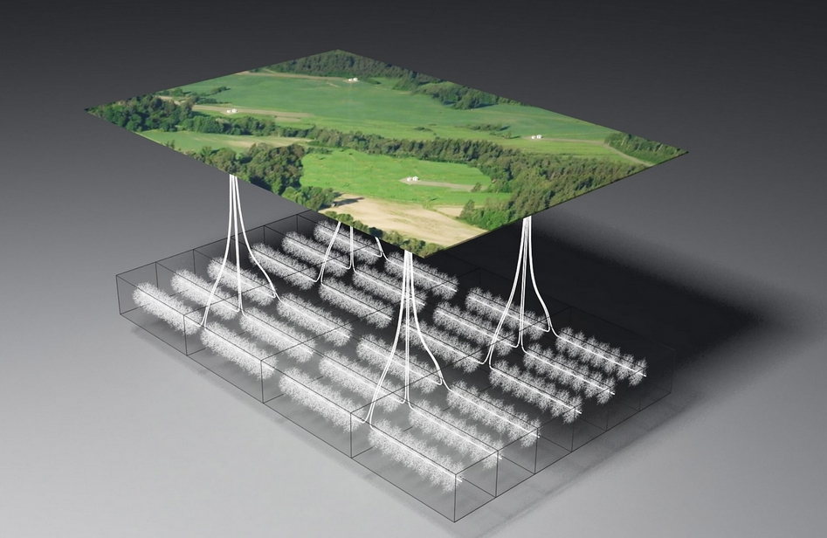
Pad Drilling Example

Slide 16
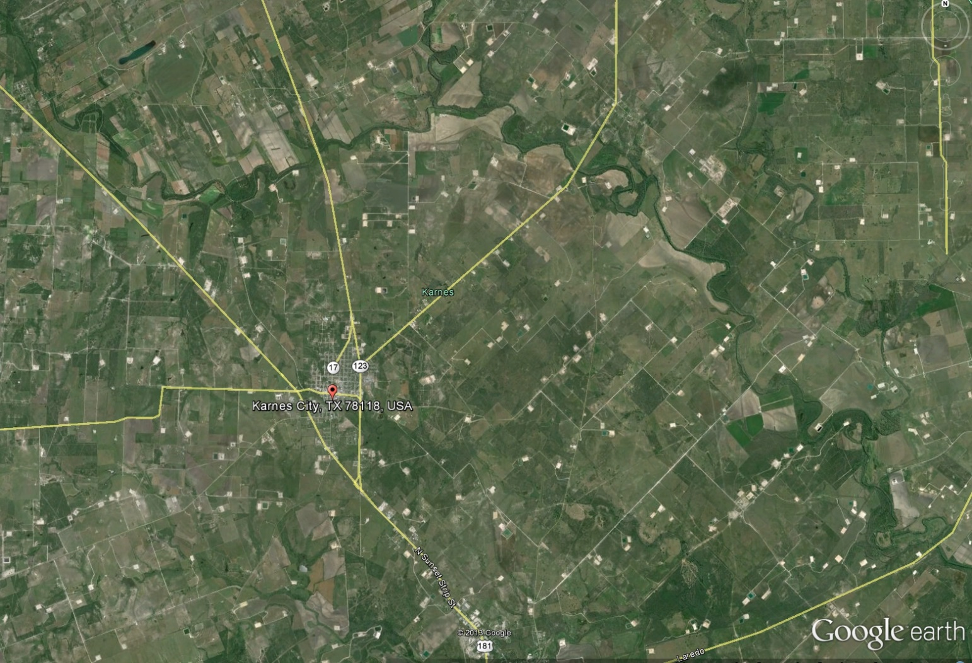
Karnes Co. Drilling Pads

Slide 17
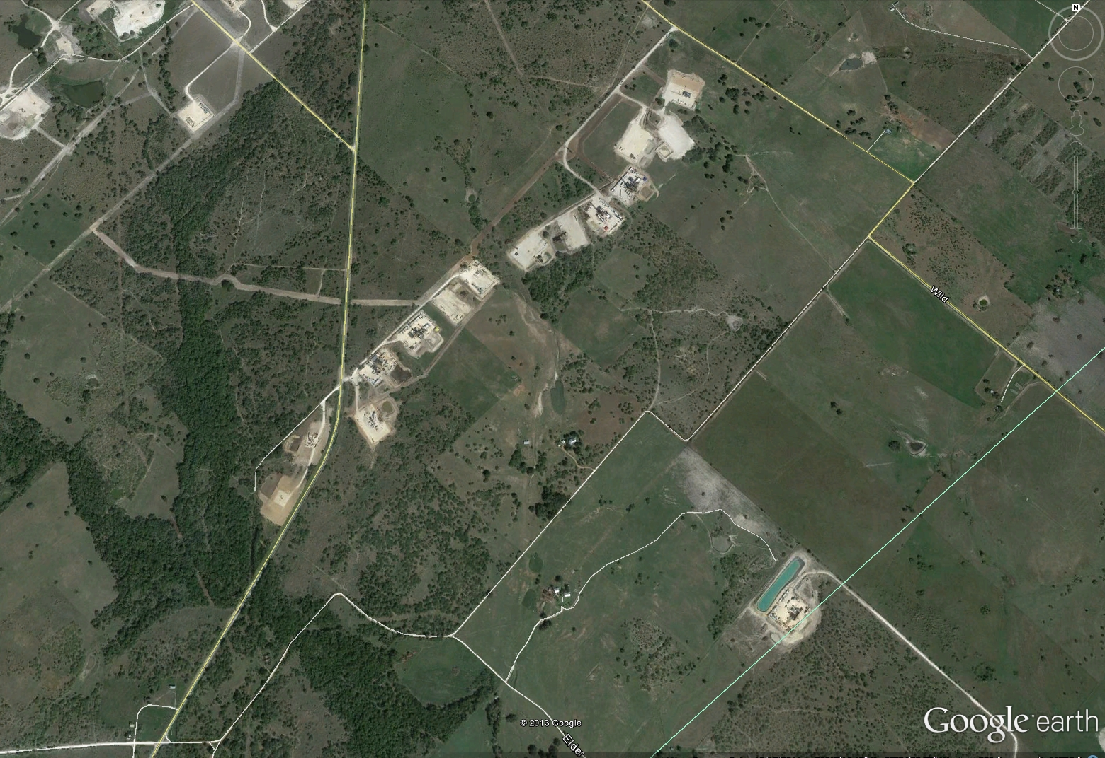
Gonzales Co. Drilling Pads

Slide 18
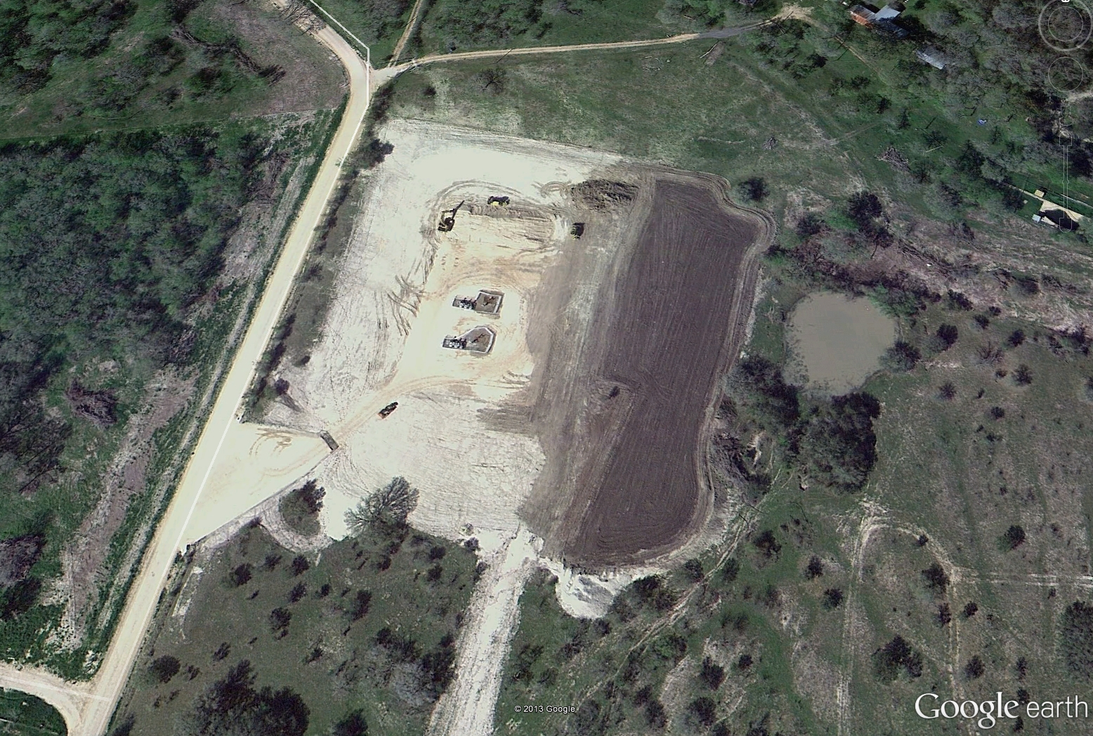
2 Wells On One Pad in Gonzales Co.

Slide 19
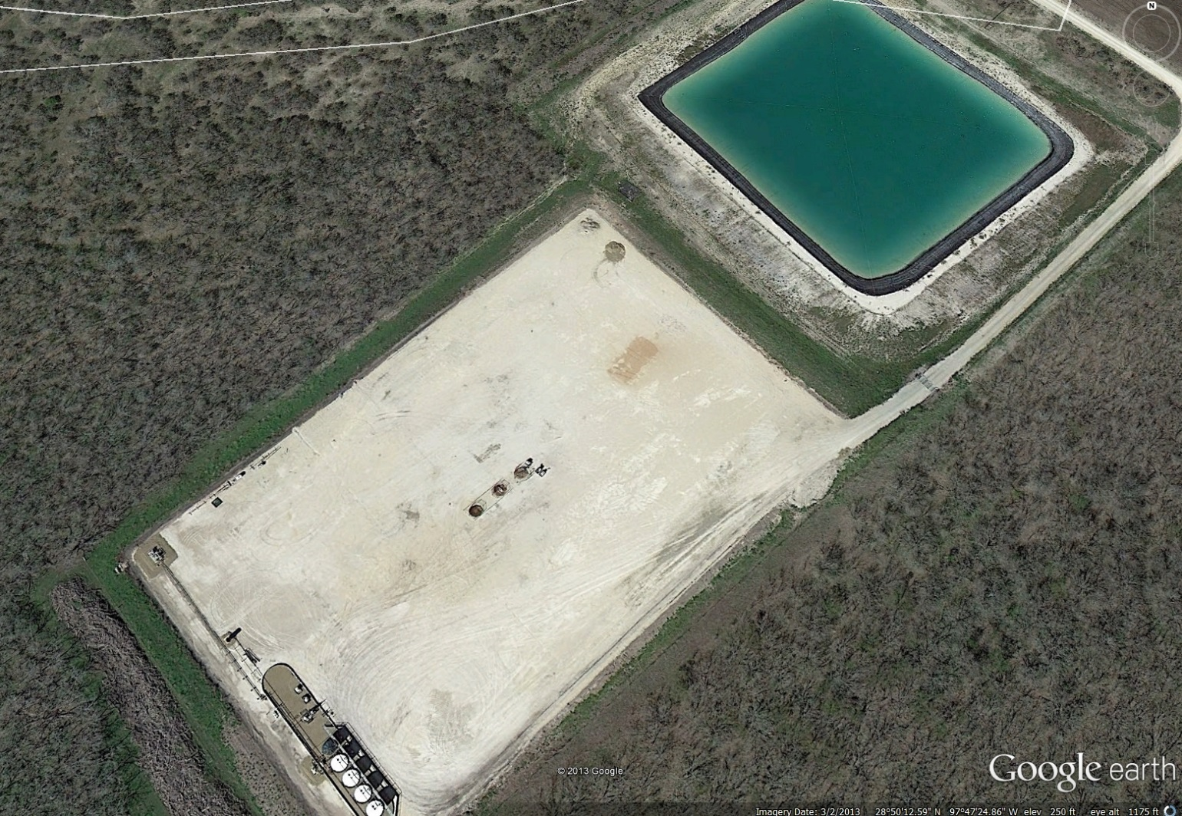
3 Wells On One Pad in Gonzales Co.

Slide 20
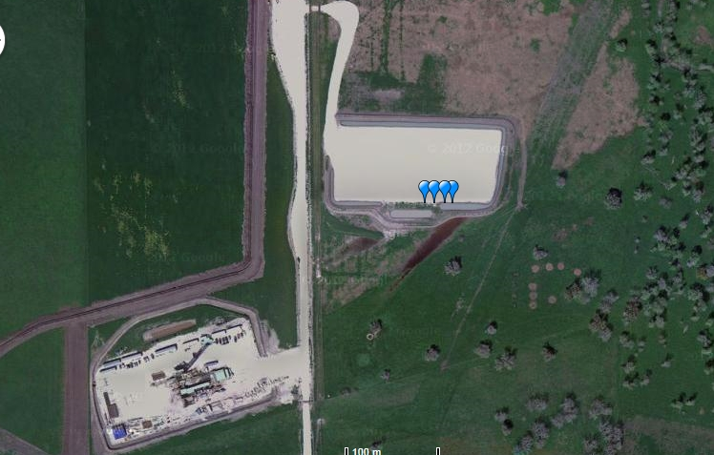
4 Wells Just Drilled by EOG in Gonzales Co. (using FracFocus.org)

Slide 21
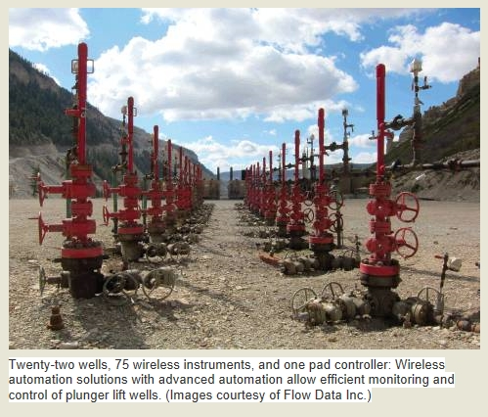
22 Wells On One Pad in Bakken

Slide 22
2) Moving the Rigs

Slide 23
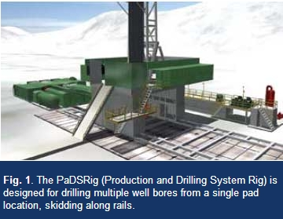
Rig Moving on Rails

Slide 24
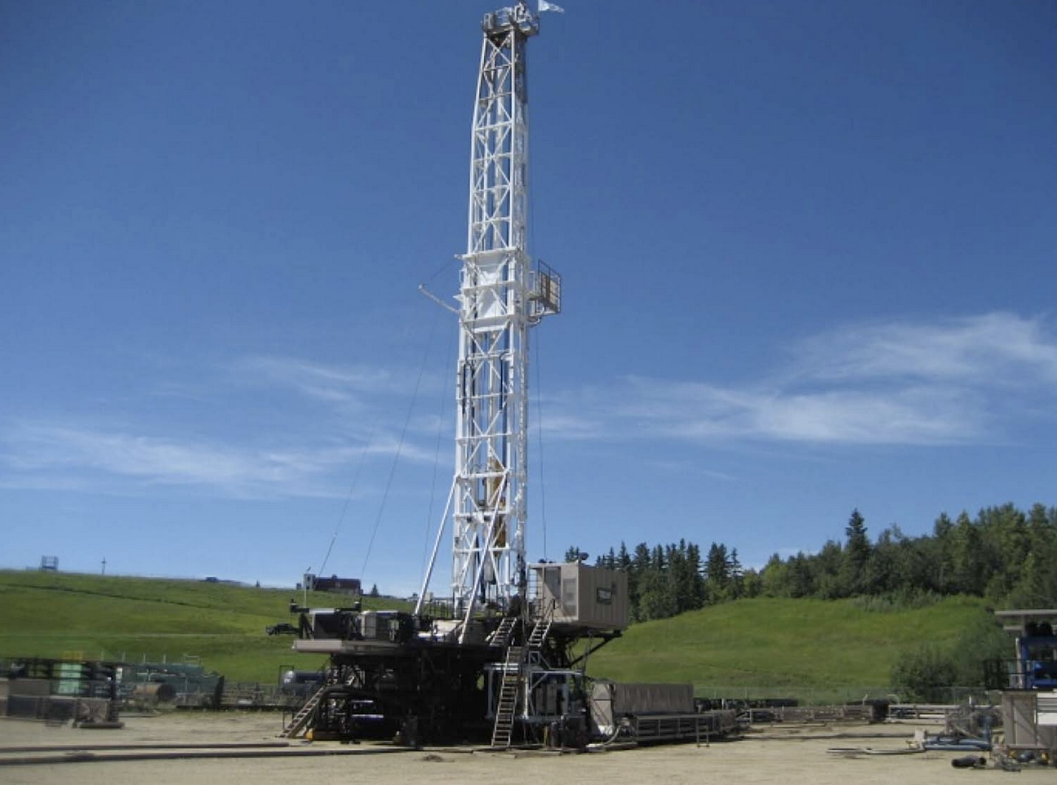
Rig Moving on Rails

Slide 25
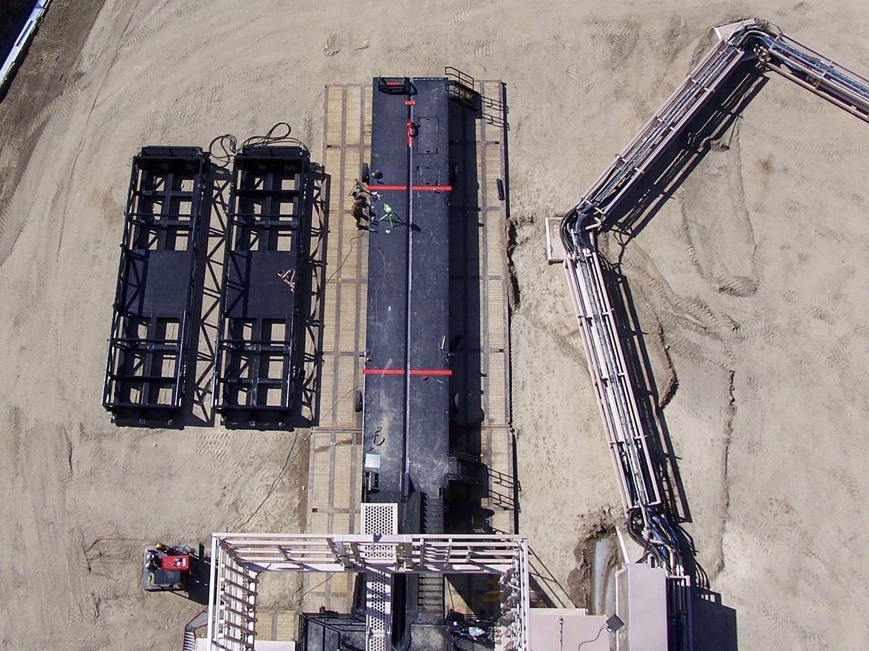
Piping Moves With Rig Movement

Slide 26
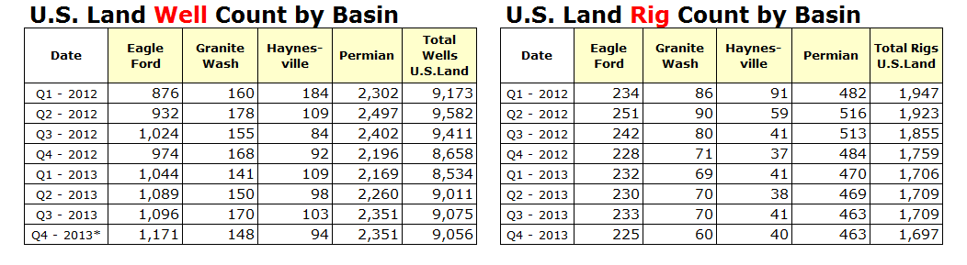
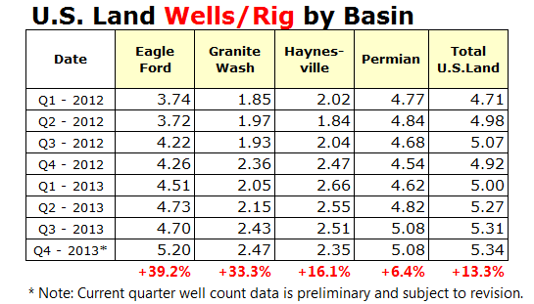
Increasing Efficiency Begins to Show Up
Started 1 well every 24 days
Started 1 well every 17 days
Source: Baker Hughes Quarterly Well Count Report

Slide 27
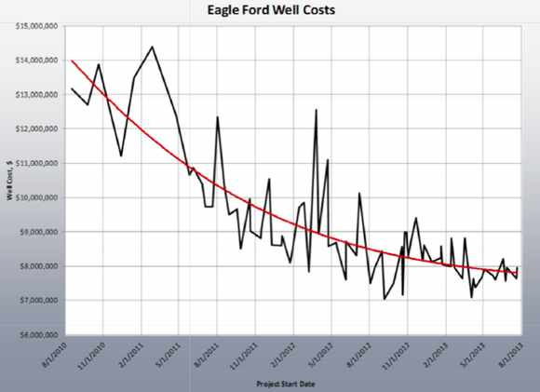
Seeing Well Costs Drop from $14 mil. to $6 mil.
Sept. 2010
Sept. 2013
Source: UTSA Economic Impact of the Eagle Ford Shale Study

Slide 28
3) Well Spacing

Slide 29
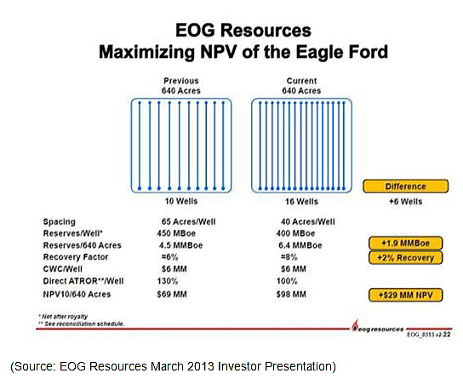
EOG Downspacing Means More Wells

Slide 30
Factors to Consider With Increased Downspacing
When laterals get close enough, they start to “communicate”
Marathon data shows two wells on 40-acre spacing will each have about 80% of the recovery as one well on 80-acre spacing.
  Ex. 1 well @ 80 acres produces 1,000 bbls of oil (Total = 1,000 bbls)
  vs
  2 wells @ 40 acres produce 800 bbls of oil each (Total = 1,600 bbls)
So increased production must be weighed against increased well cost (may only work on the best “sweet spots”).

Slide 31
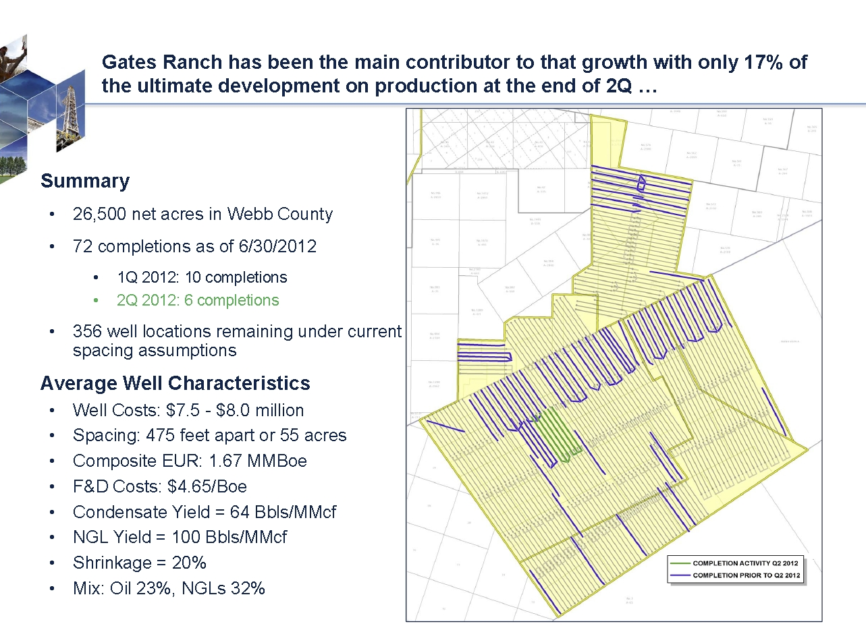
Rosetta Resources Map of Its Well Spacing Plan
Source: Rosetta Resources

Slide 32
My Revised Guess of Future Eagle Ford Drilling Activity
The Dallas Federal Reserve reported that 5 mil. acres of the Eagle Ford are under lease.
So my latest guess is:
  4 mil. acres/80 acres drained per well = 50k total wells
  200 rigs x 20 wells drilled per yr. = 4,000 wells per yr.
  50k wells needed/4,000 wells per yr. = 12.5 years to drill
* However, a few other factors could extend this timeline.

Slide 33
4) Tapping Other Pay Zones in the Future

Slide 34
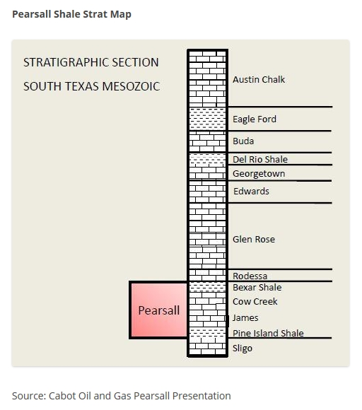
Multiple Payzones Could Extend the Long-term Life of a Field
Austin Chalk
Eagle Ford
Buda
Pearsall

Slide 35
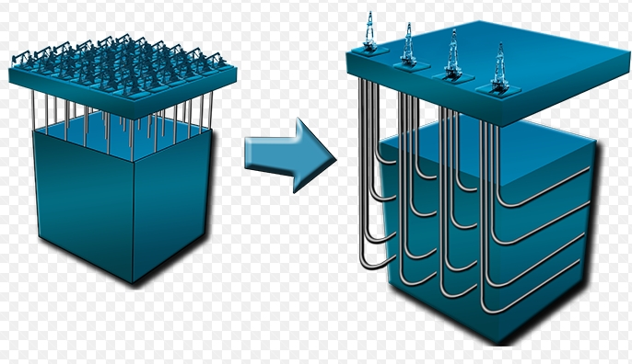
Horizontal Wells Using Pad Drilling in Multiple Stacked Plays

Slide 36
Also Experimenting With
“Stacked Lateral” Development
Within the Eagle Ford Play

Slide 37
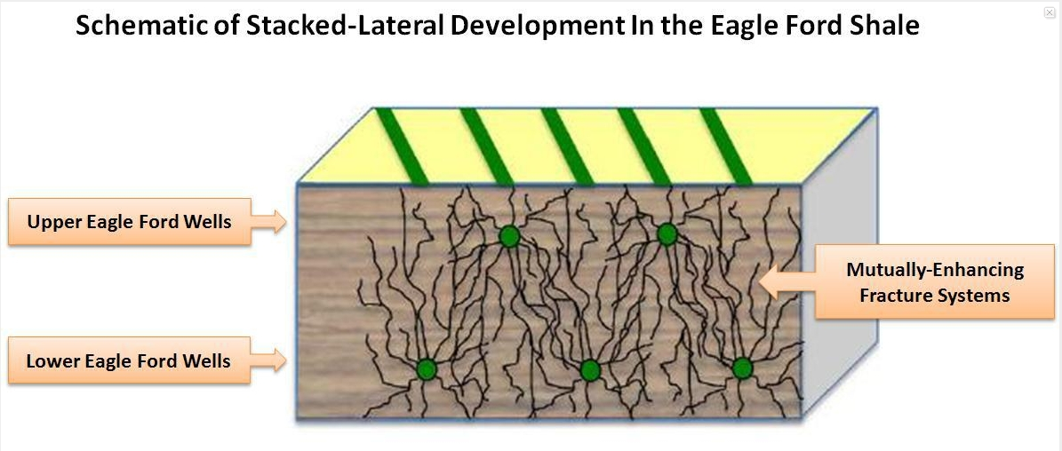
Stacked Laterals Being Tested by Rosetta Resources in the Gates Ranch Field
Source: SeekingAlpha Article Nov. 18, 2013

Slide 38
Finally, Don’t Forget the Possibility of “Secondary Recovery” (ex. Re-fracking) Activity on Existing Wells

Slide 39
Changing Gears
Exploring La Salle County
Economic Data

Slide 40
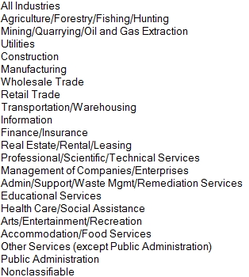
Texas Gross Sales Categories Subject to Sales Tax
Source: Texas Comptroller’s Office

Slide 41
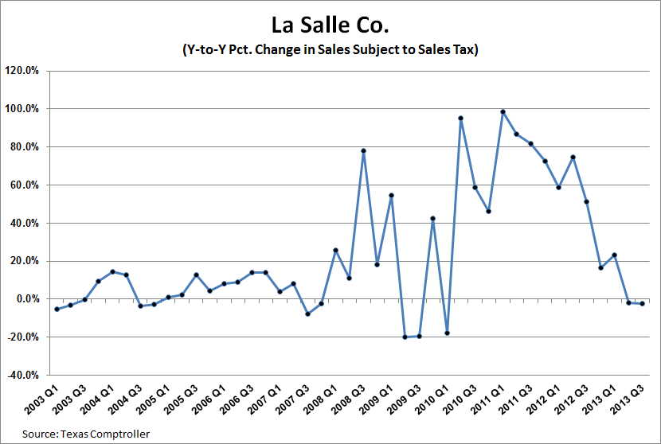
La Salle Co. Gross Sales
(Quarterly from Q2 2003 to Q3 2013)
- 2.3%
2013 Q3 Dollars of Sales Subj. to Sales Tax: $33.7 million

Slide 42
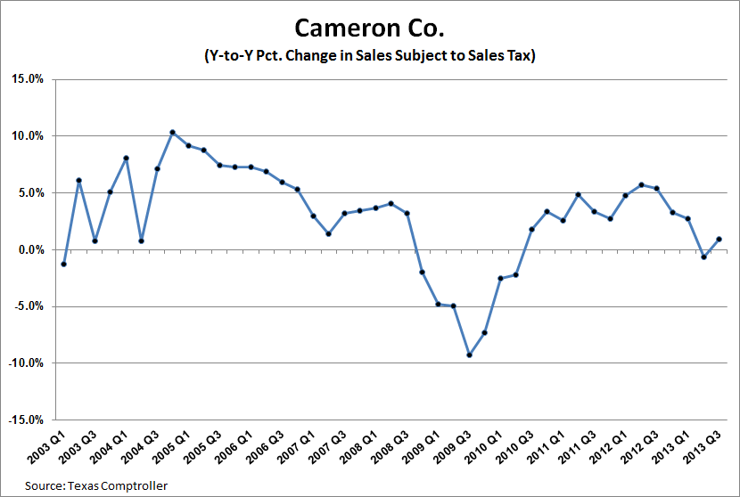
Cameron Co. Gross Sales
(Quarterly from Q2 2003 to Q3 2013)
+ 0.9%
2013 Q3 Dollars of Sales Subj. to Sales Tax: $690 million

Slide 43
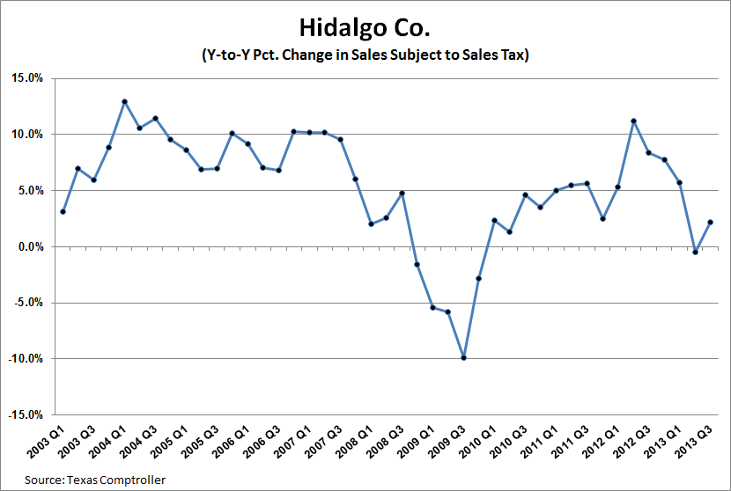
Hidalgo Co. Gross Sales
(Quarterly from Q2 2003 to Q3 2013)
+ 2.1%
2013 Q3 Dollars of Sales Subj. to Sales Tax: $1.4 billion

Slide 44
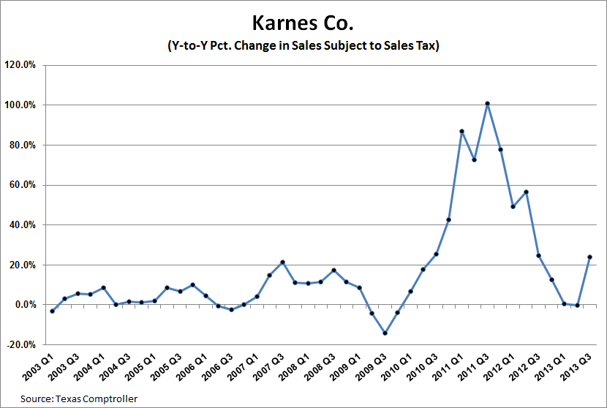
Karnes Co. Gross Sales
(Quarterly from Q2 2003 to Q3 2013)
+ 23.9%
2013 Q3 Dollars of Sales Subj. to Sales Tax: $52.9 million

Slide 45
Employment

Slide 46
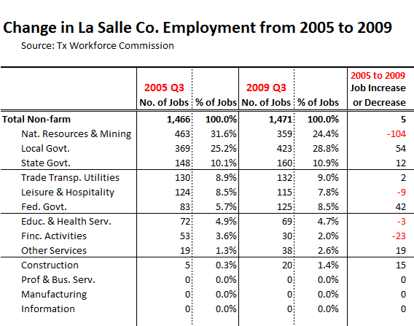
La Salle Co. Employment Growth
(Sorted by: Sector that had the Highest Number of Jobs in 2005)

Slide 47
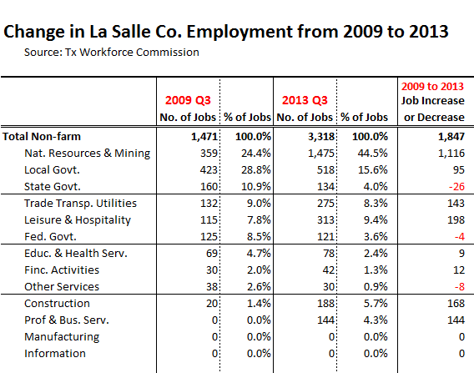
La Salle Co. Employment Growth
(Still sorted by: Sector that had the Highest Number of Jobs in 2005)

Slide 48
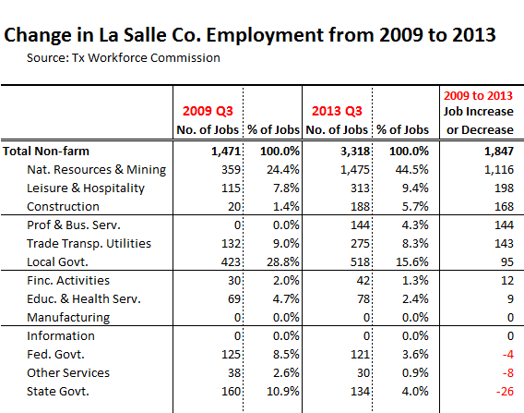
La Salle Co. Employment Growth
(Sorted by: Highest to Lowest Job Increases from 2009 to 2013)

Slide 49
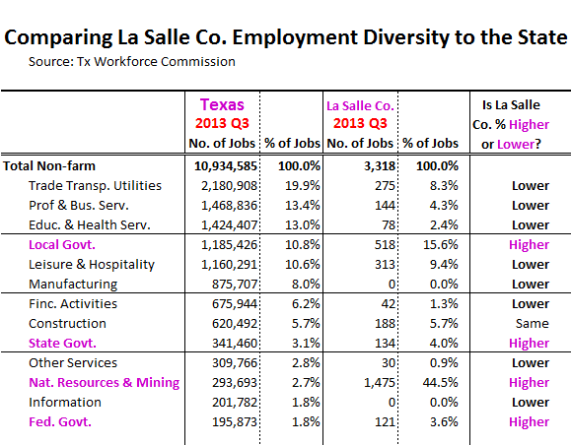
Economic Diversity: La Salle Co. is Heavier than the State in Govt. & O&G (Sorted by: Highest % of Texas Jobs)

Slide 50
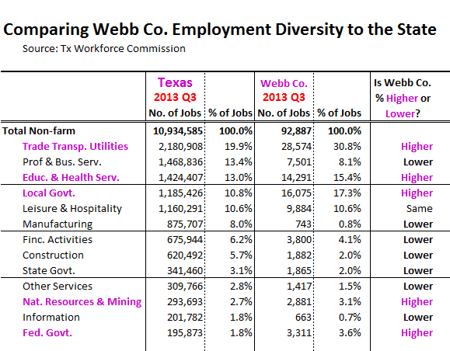
Webb Co. is Heavier in Trade & Transportation, Health Services, O&G, and Govt.

Slide 51
Most Smaller Texas MSAs will Have:
2 “Constant” Sectors and 1 “Wildcard”

Slide 52
Wrapping-up

Slide 53
What Could Derail This O&G Boom
A major breakthrough in renewables
Water availability or contamination endangering aquifers or surface
Govt. involvement becomes too onerous
  (ex. EPA severely regulates: water disposal, air quality, frack fluids
  (ex. 2. U.S. Fish & Wildlife: finds endangered species in area)
The big one: A severe drop in crude price

Slide 54
Unknowns that Could Affect Price
How fast will drilling technology improve?
  “Decline rate” & “recovery rate” improvements
  Drilling costs (drilling times; completion techniques; water usage, etc.)
How much LNG will be exported from the US?
  Pits Petrochems, Manufacturing, Elect. power against Producers
Will restrictions on exporting crude be lifted?
  Pits Refiners against Producers
Will major Gulf Coast refineries retool to handle more U.S. light crude?

Slide 55
Two Final Points
(How is this O&G boom different from the 80’s?)

Slide 56
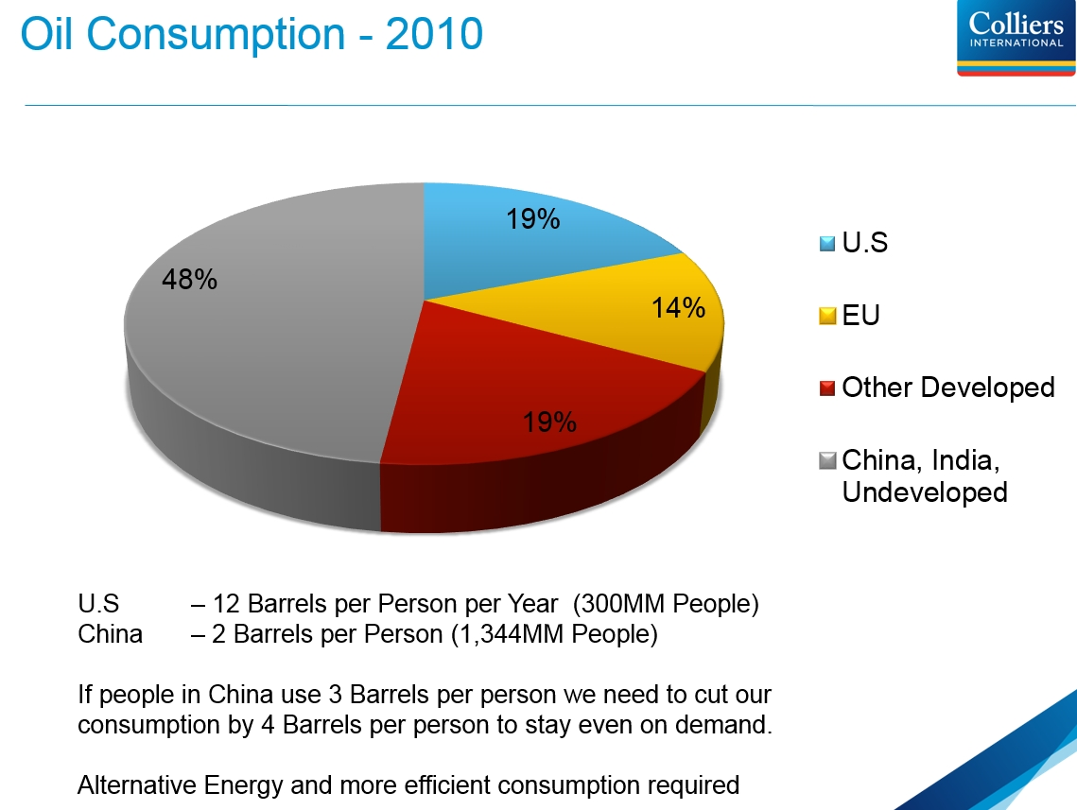

Remember: “Developing” Countries Will Be Driving Future Oil Consumption
Source: Oil & Gas Investor Magazine

Slide 57
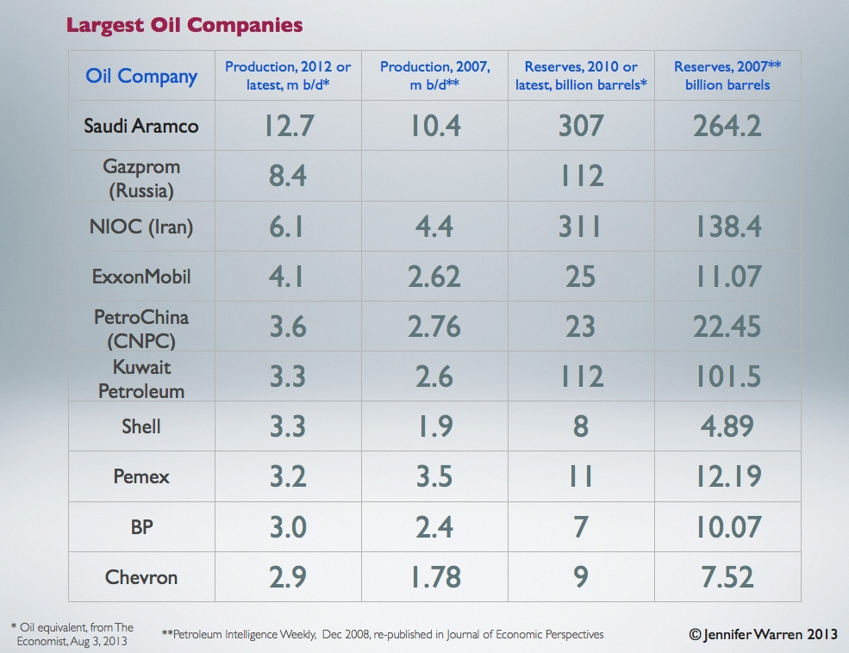
Consider: 6 of Top 10 Oil Companies Globally are “Government-controlled”
$93.40
Saudi Arabia
$101.70
Russia
Iran
China
Kuwait
Mexico
Breakeven Oil Price Source: April 11, 2014 Bloomberg article: “Venezuela Needs 2014 Brent Oil Price of $121”

Slide 58
REAL ESTATE CENTER
at TEXAS A&M UNIVERSITY
Mays School of Business
http://recenter.tamu.edu

