Slide 1
TEEX First Responder Summit
PHMSA Battery Transportation Incidents and Resources

Slide 2
Topics Covered
Battery Transportation Incidents
Emergency Waivers
Emergency Special Permits
Class 9 Subdivisions
PHMSA Resources

Slide 3
Battery Transportation Incidents
PHMSA – 2026

Slide 4
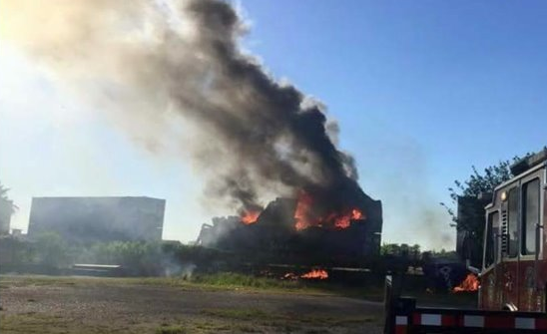
Houston, TX (Railroad)
Shipping container
exploded while in
transportation by rail.
There was no warning or indication that batteries were involved.

Slide 5
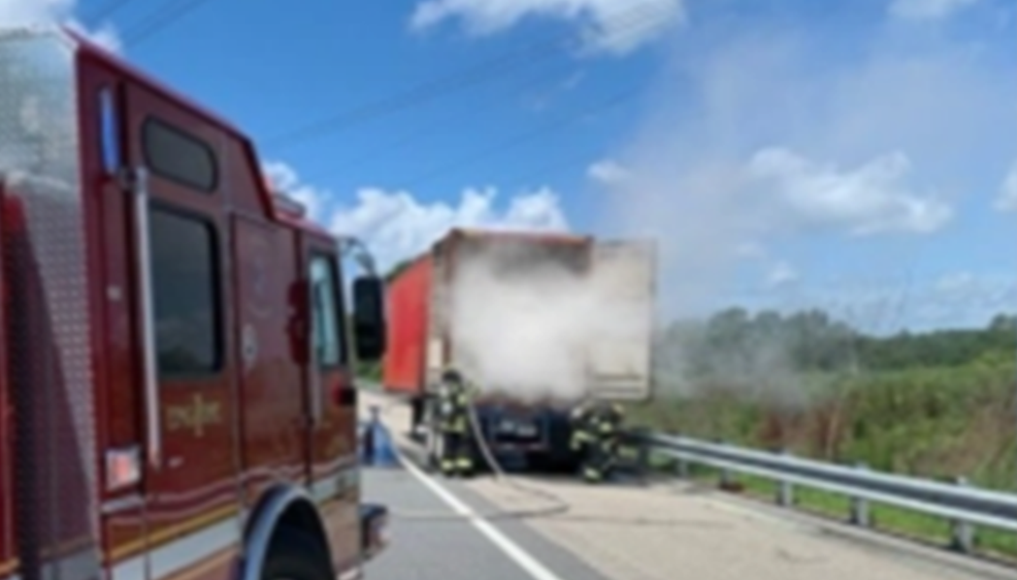
Suffolk, VA
Ground shipment
headed to a port

Slide 6
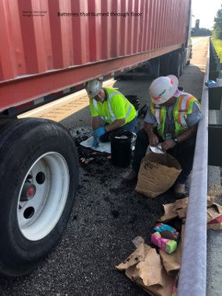
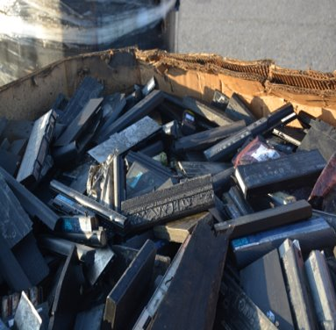
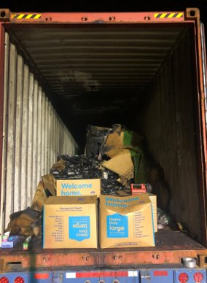
Suffolk, VA

Slide 7
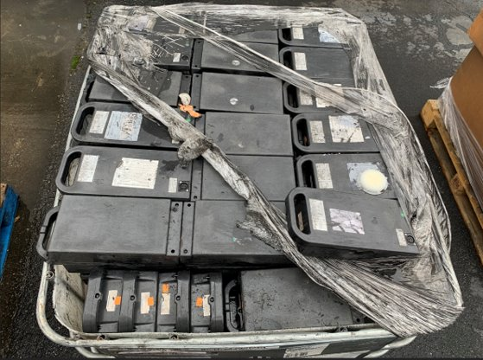
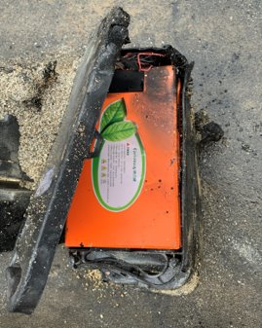
Lawrenceville, GA

Slide 8
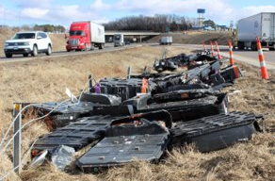
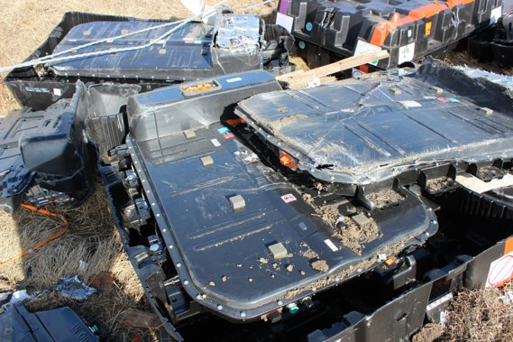
Rolla, MO

Slide 9
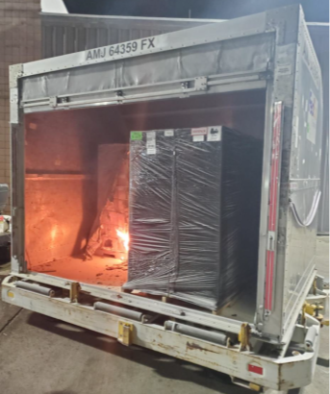
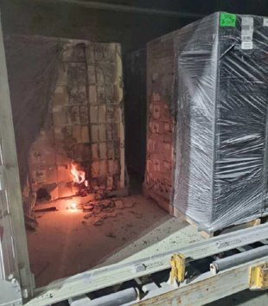
San Antonio, TX (Air)
Use of black
shrink-wrap made it difficult to see damage
that impacted the
cellphones/batteries
in the packages.

Slide 10
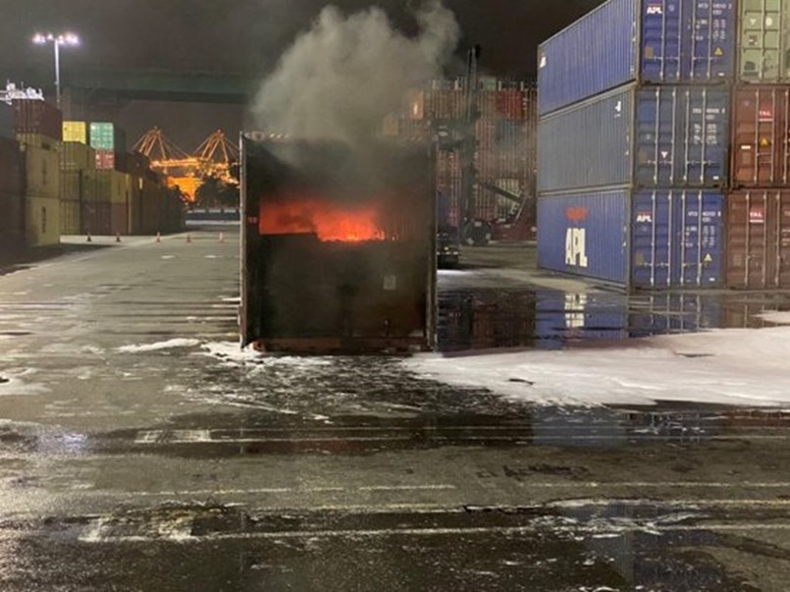
LA/Long Beach, CA (Port)
Shipper described the contents as
Synthetic Resins N.O.S.​
Many other containers were found in the port and loaded on ships with the same description

Slide 11
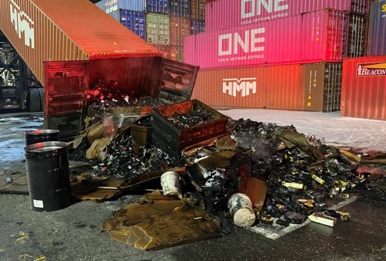
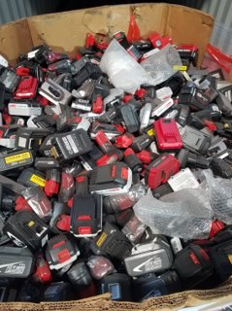
LA/Long Beach, CA (Port)

Slide 12
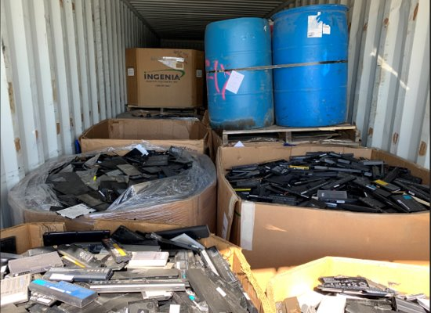
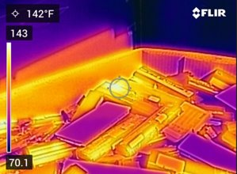
LA/Long Beach, CA (Port)
Container of undeclared batteries involved associated with the previous container contains laptop batteries.

Slide 13
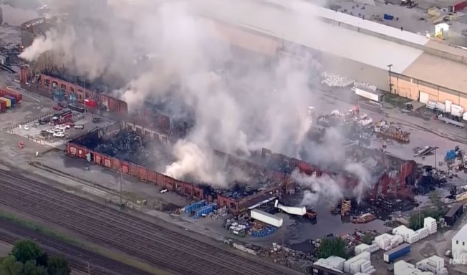
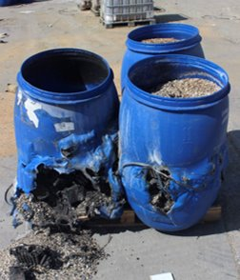
Madison, IL (International Import Shipment)

Slide 14
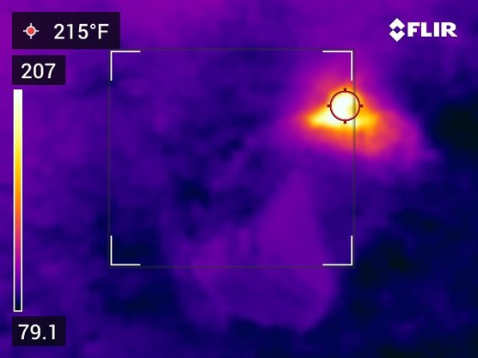
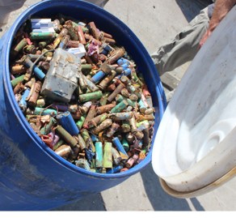
Madison, IL (International Import Shipment)

Slide 15
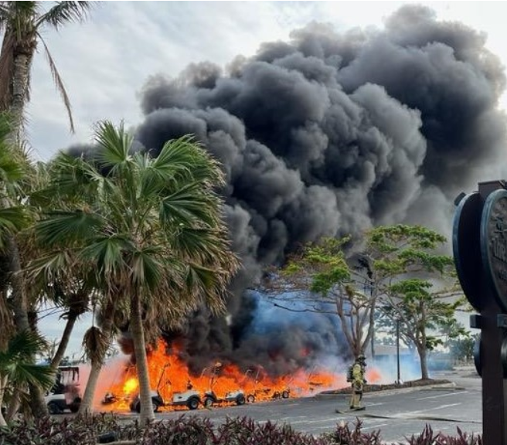
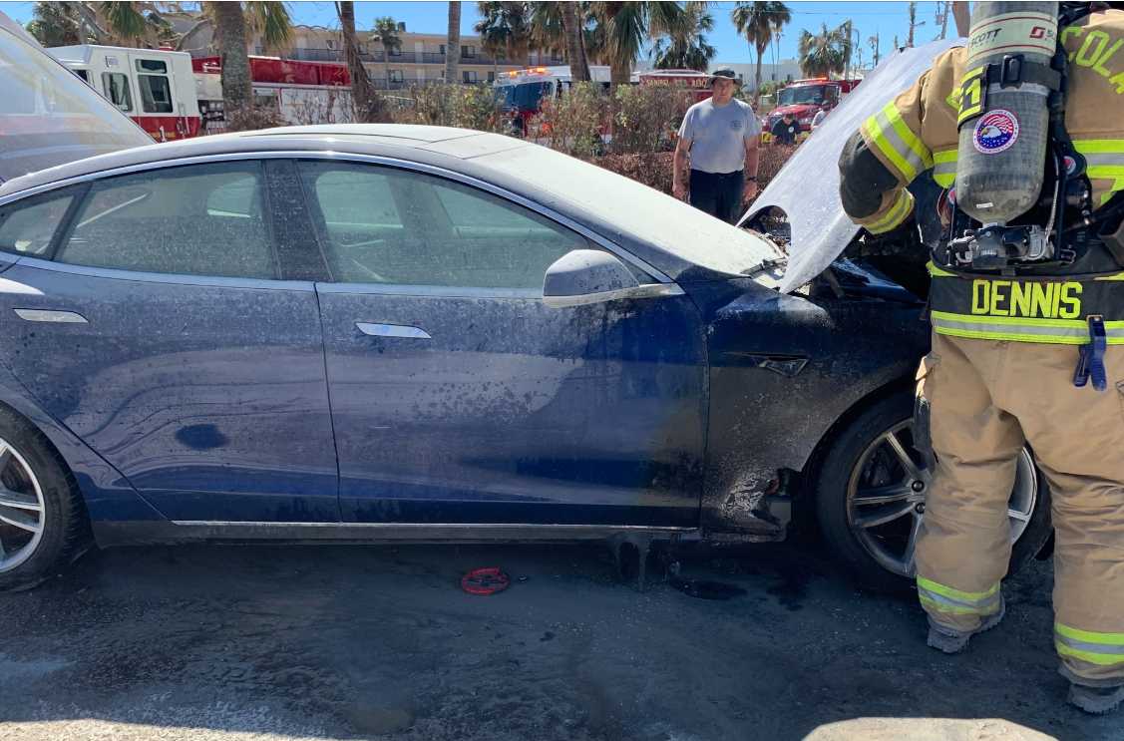
Hurricanes – September 2022
Hundreds of EV’s and thousands of devices exposed to sea water and other forces associated with hurricanes.

Slide 16
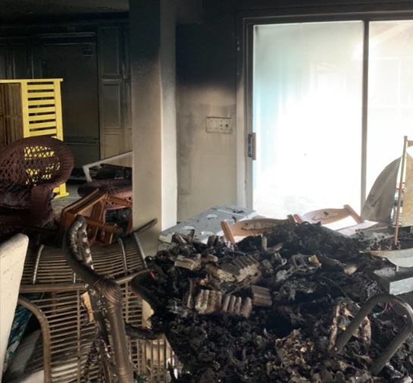
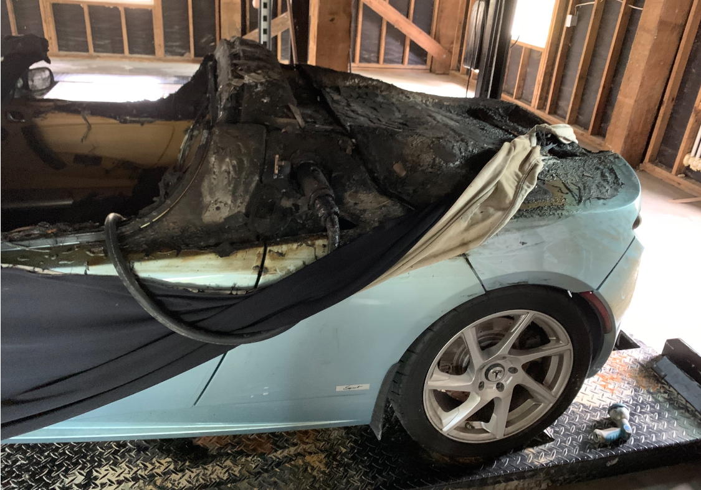
Hurricanes – September 2022

Slide 17
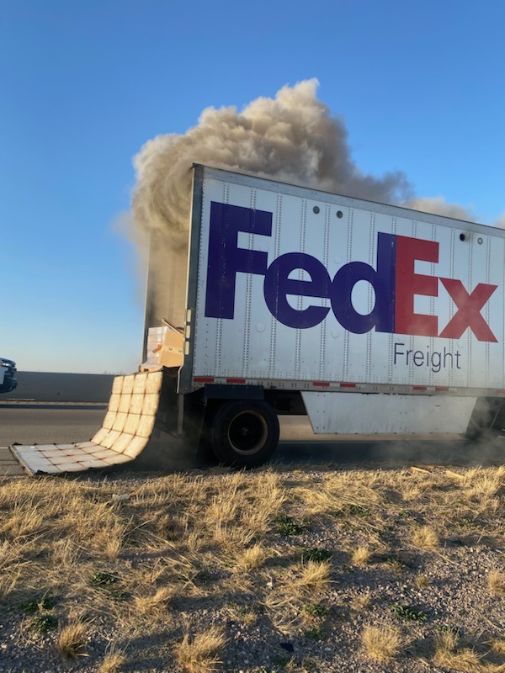
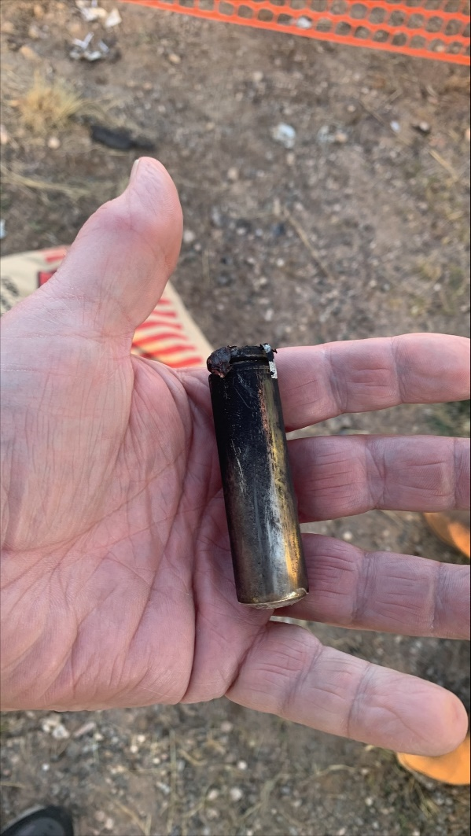
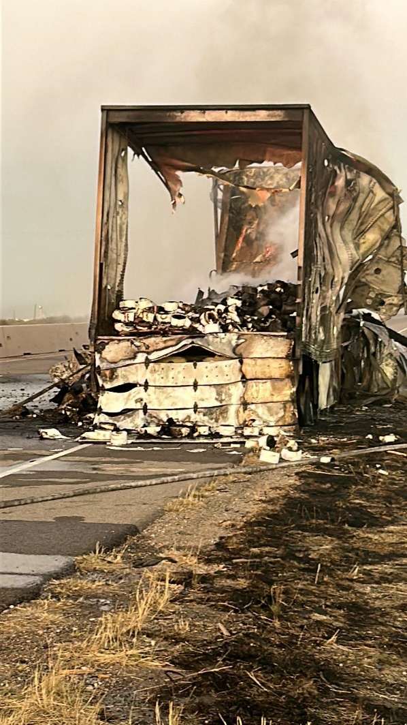
Monahan, TX (OTR)

Slide 18
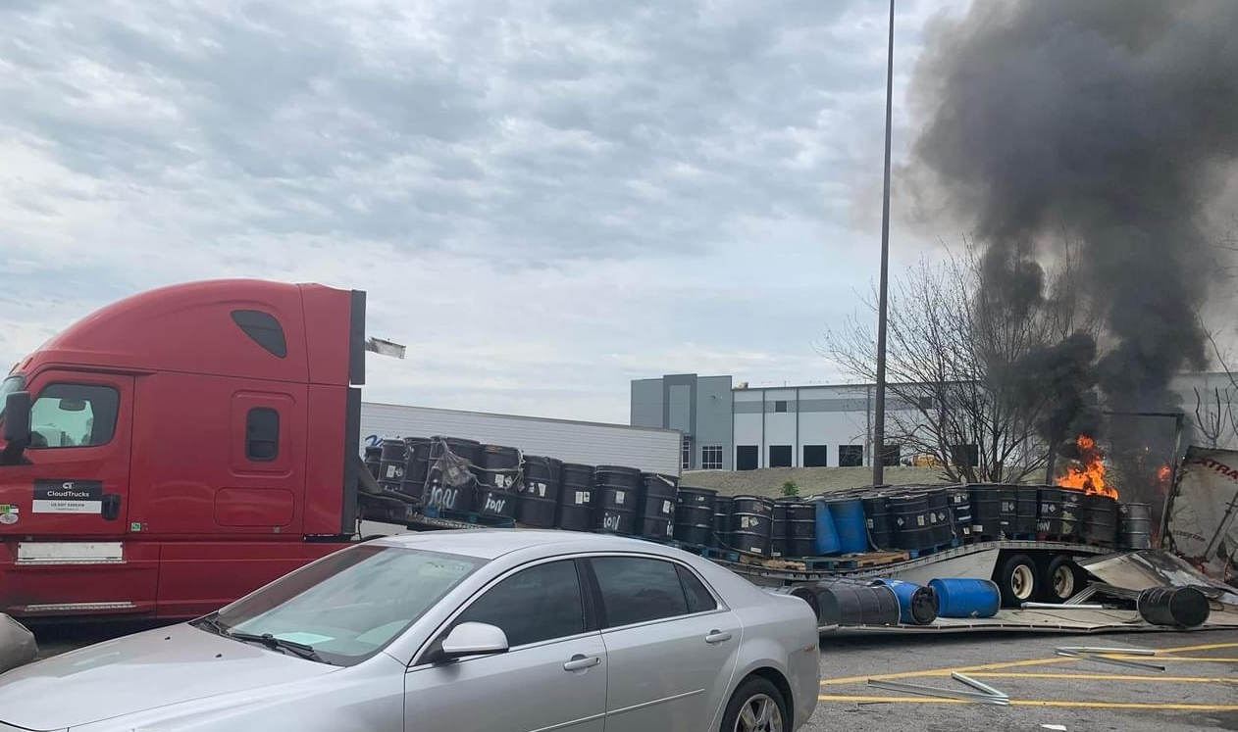
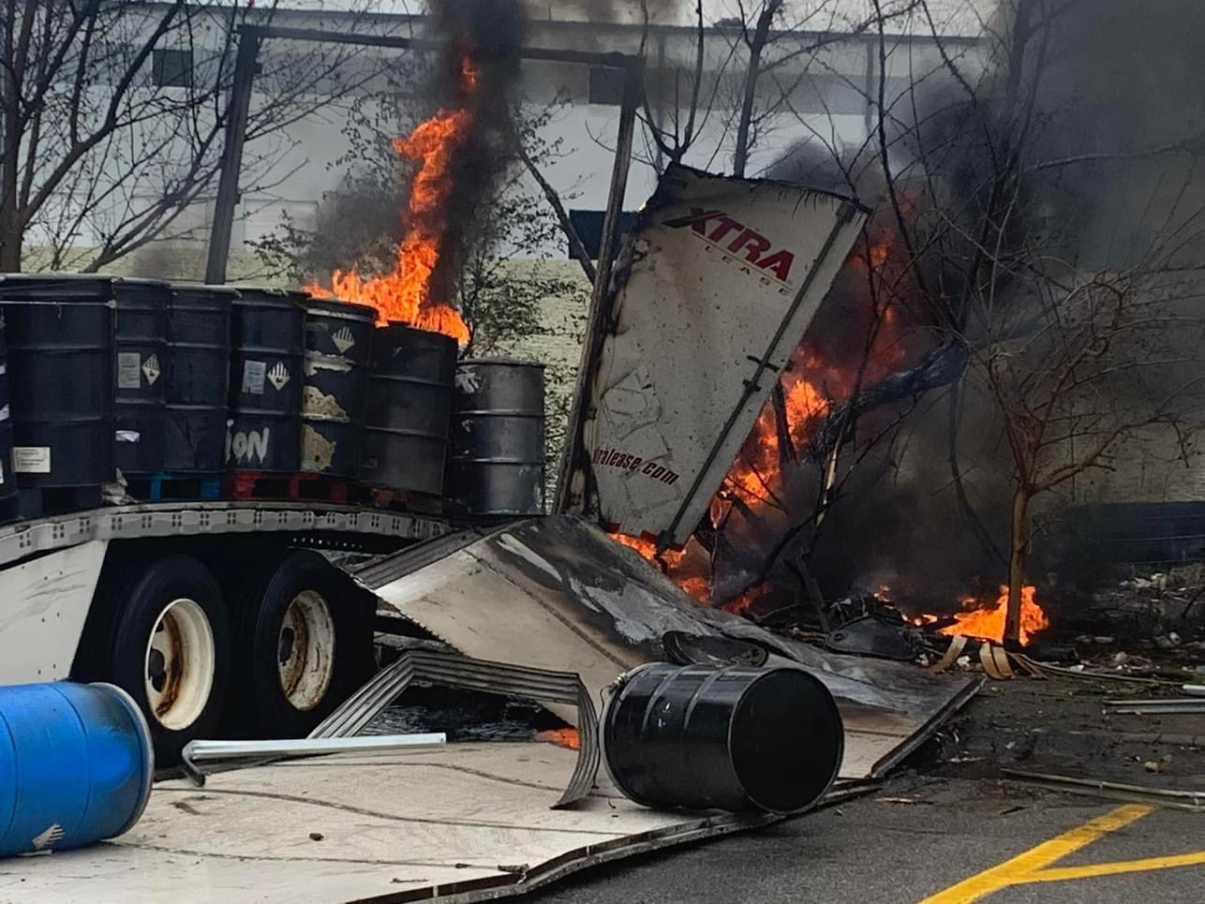
Birmingham, AL (OTR)

Slide 19
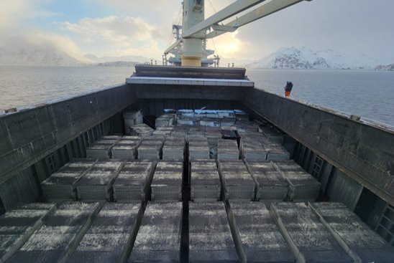
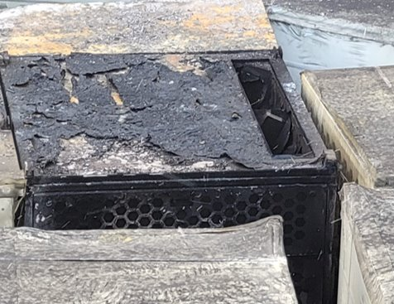
Dutch Harbor, AK

Slide 20

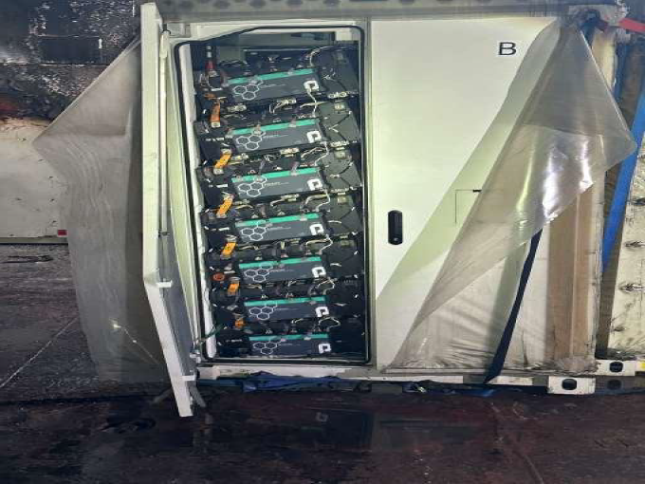
Dutch Harbor, AK

Slide 21

Highpoint, WA

Slide 22
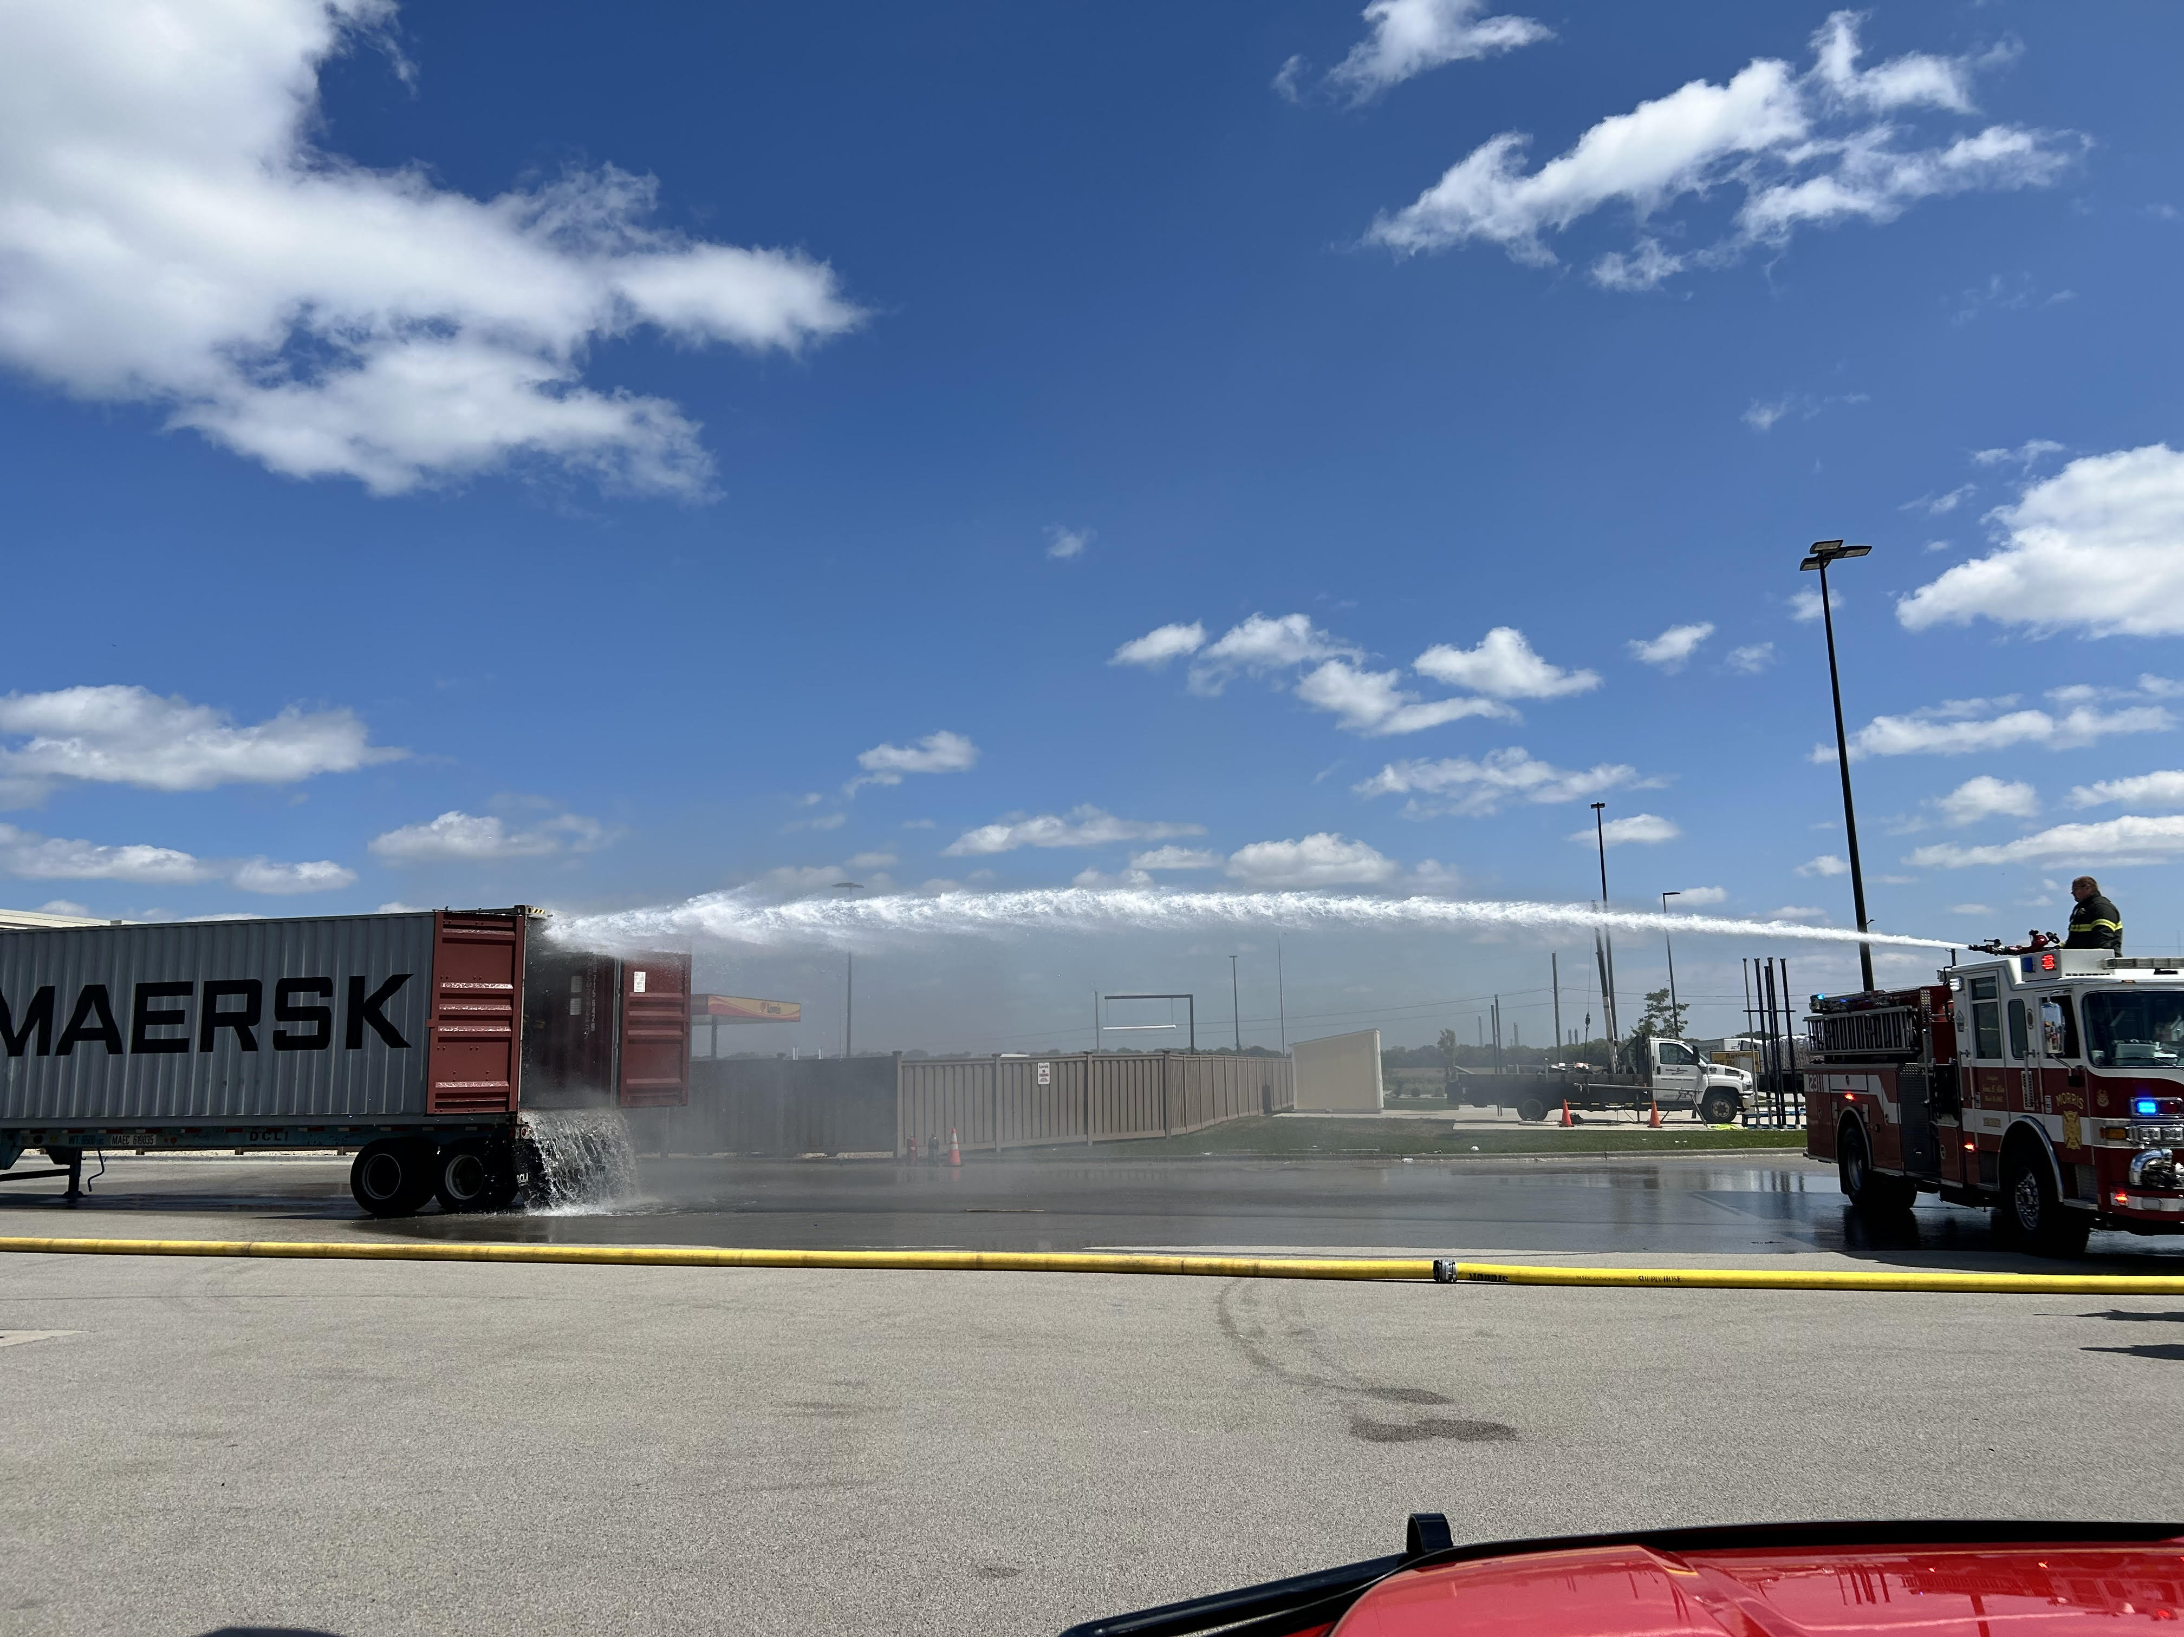
Morris, IL

Slide 23
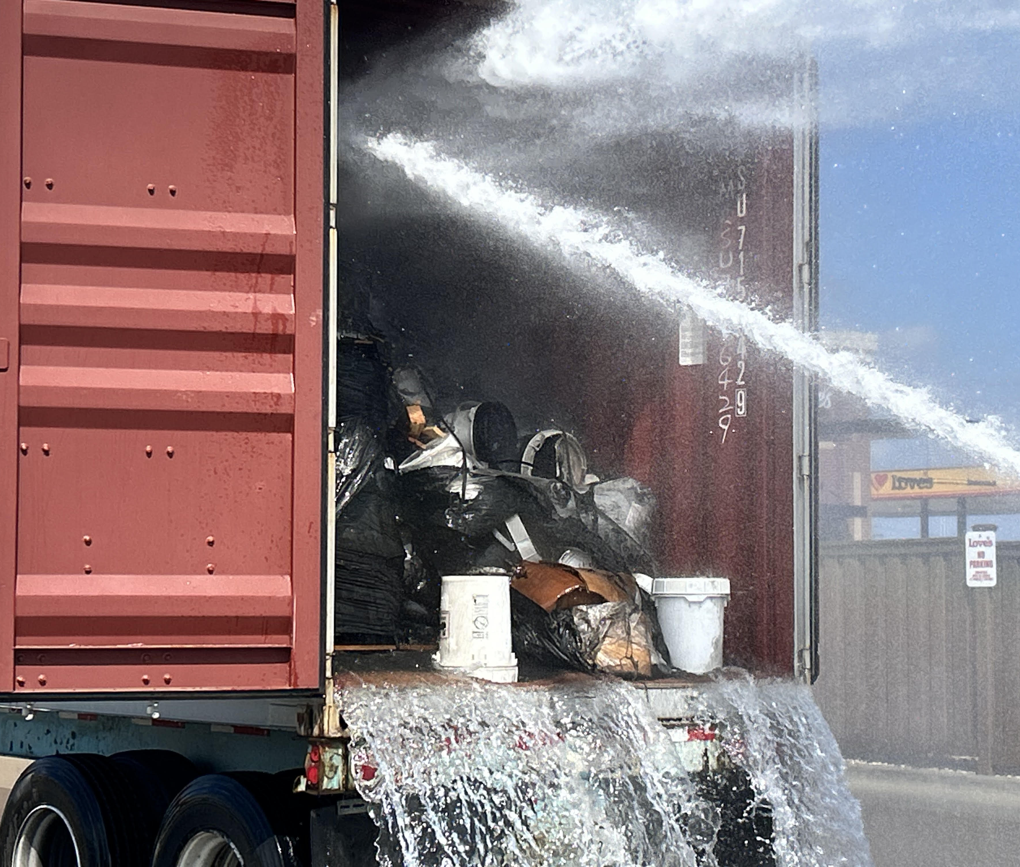
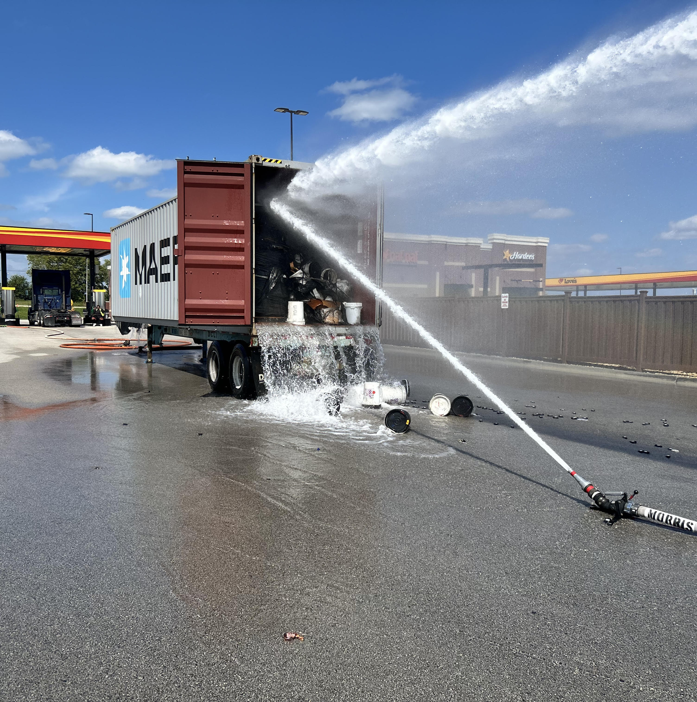
Morris, IL

Slide 24
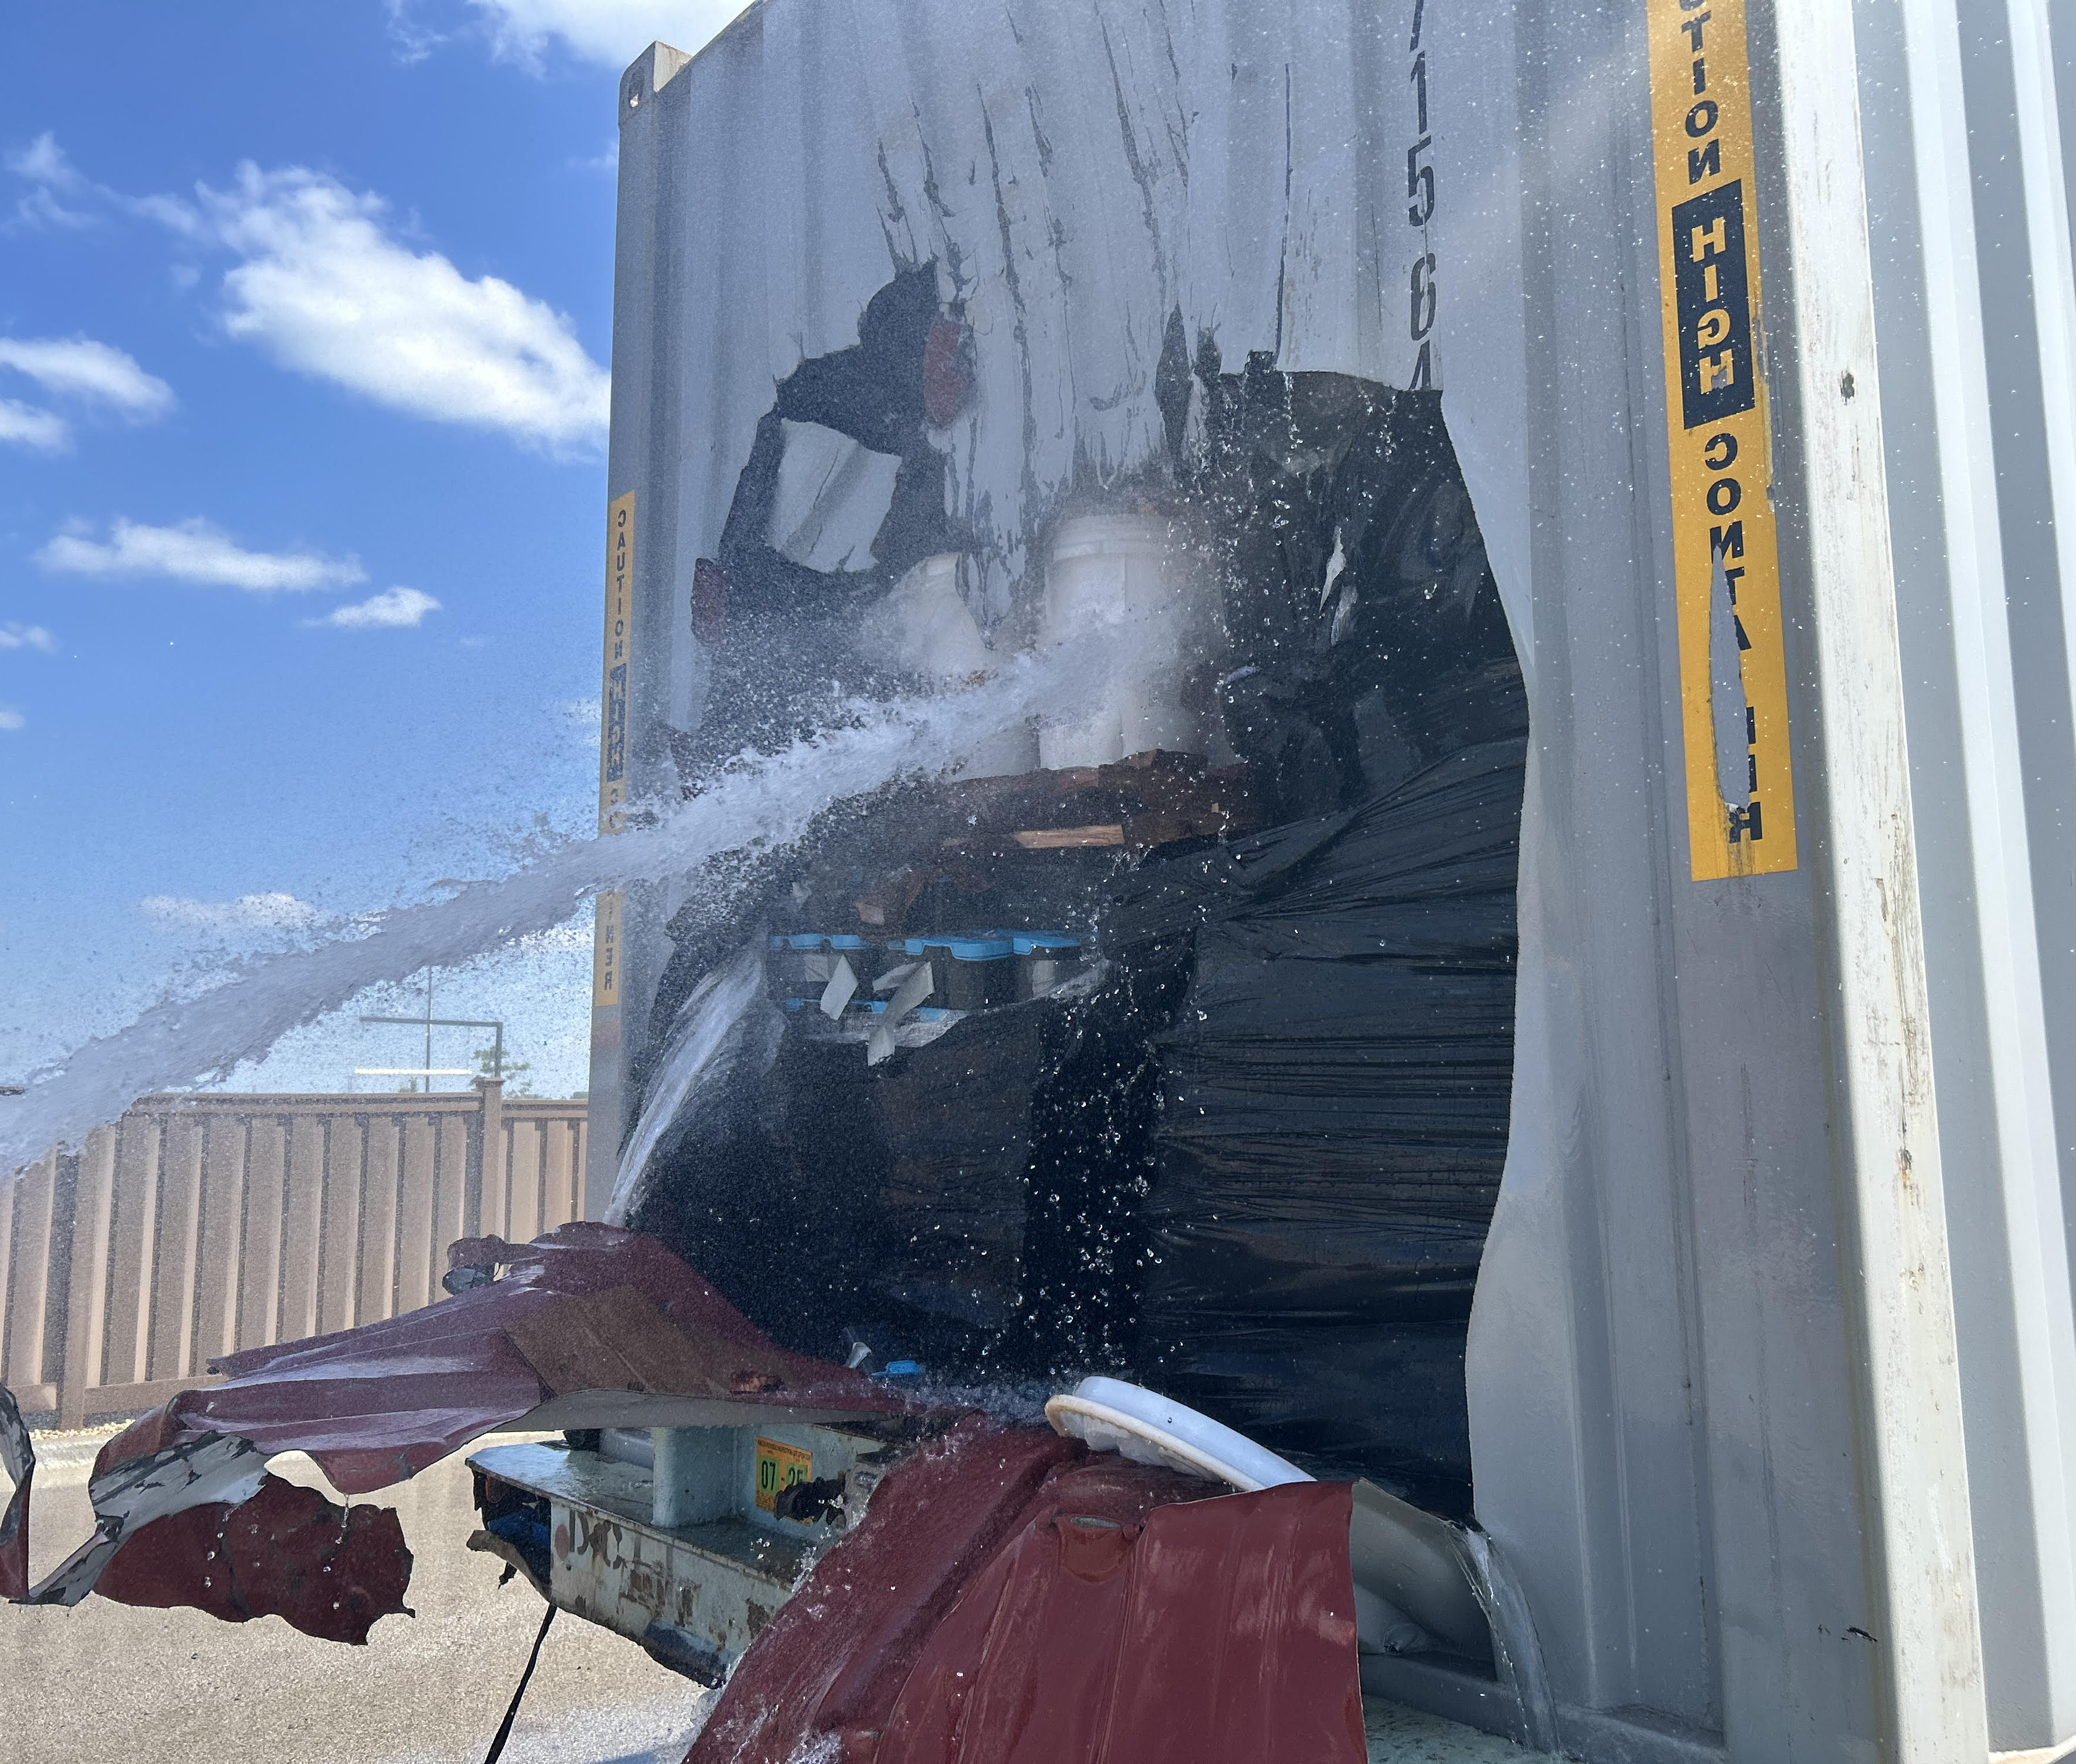
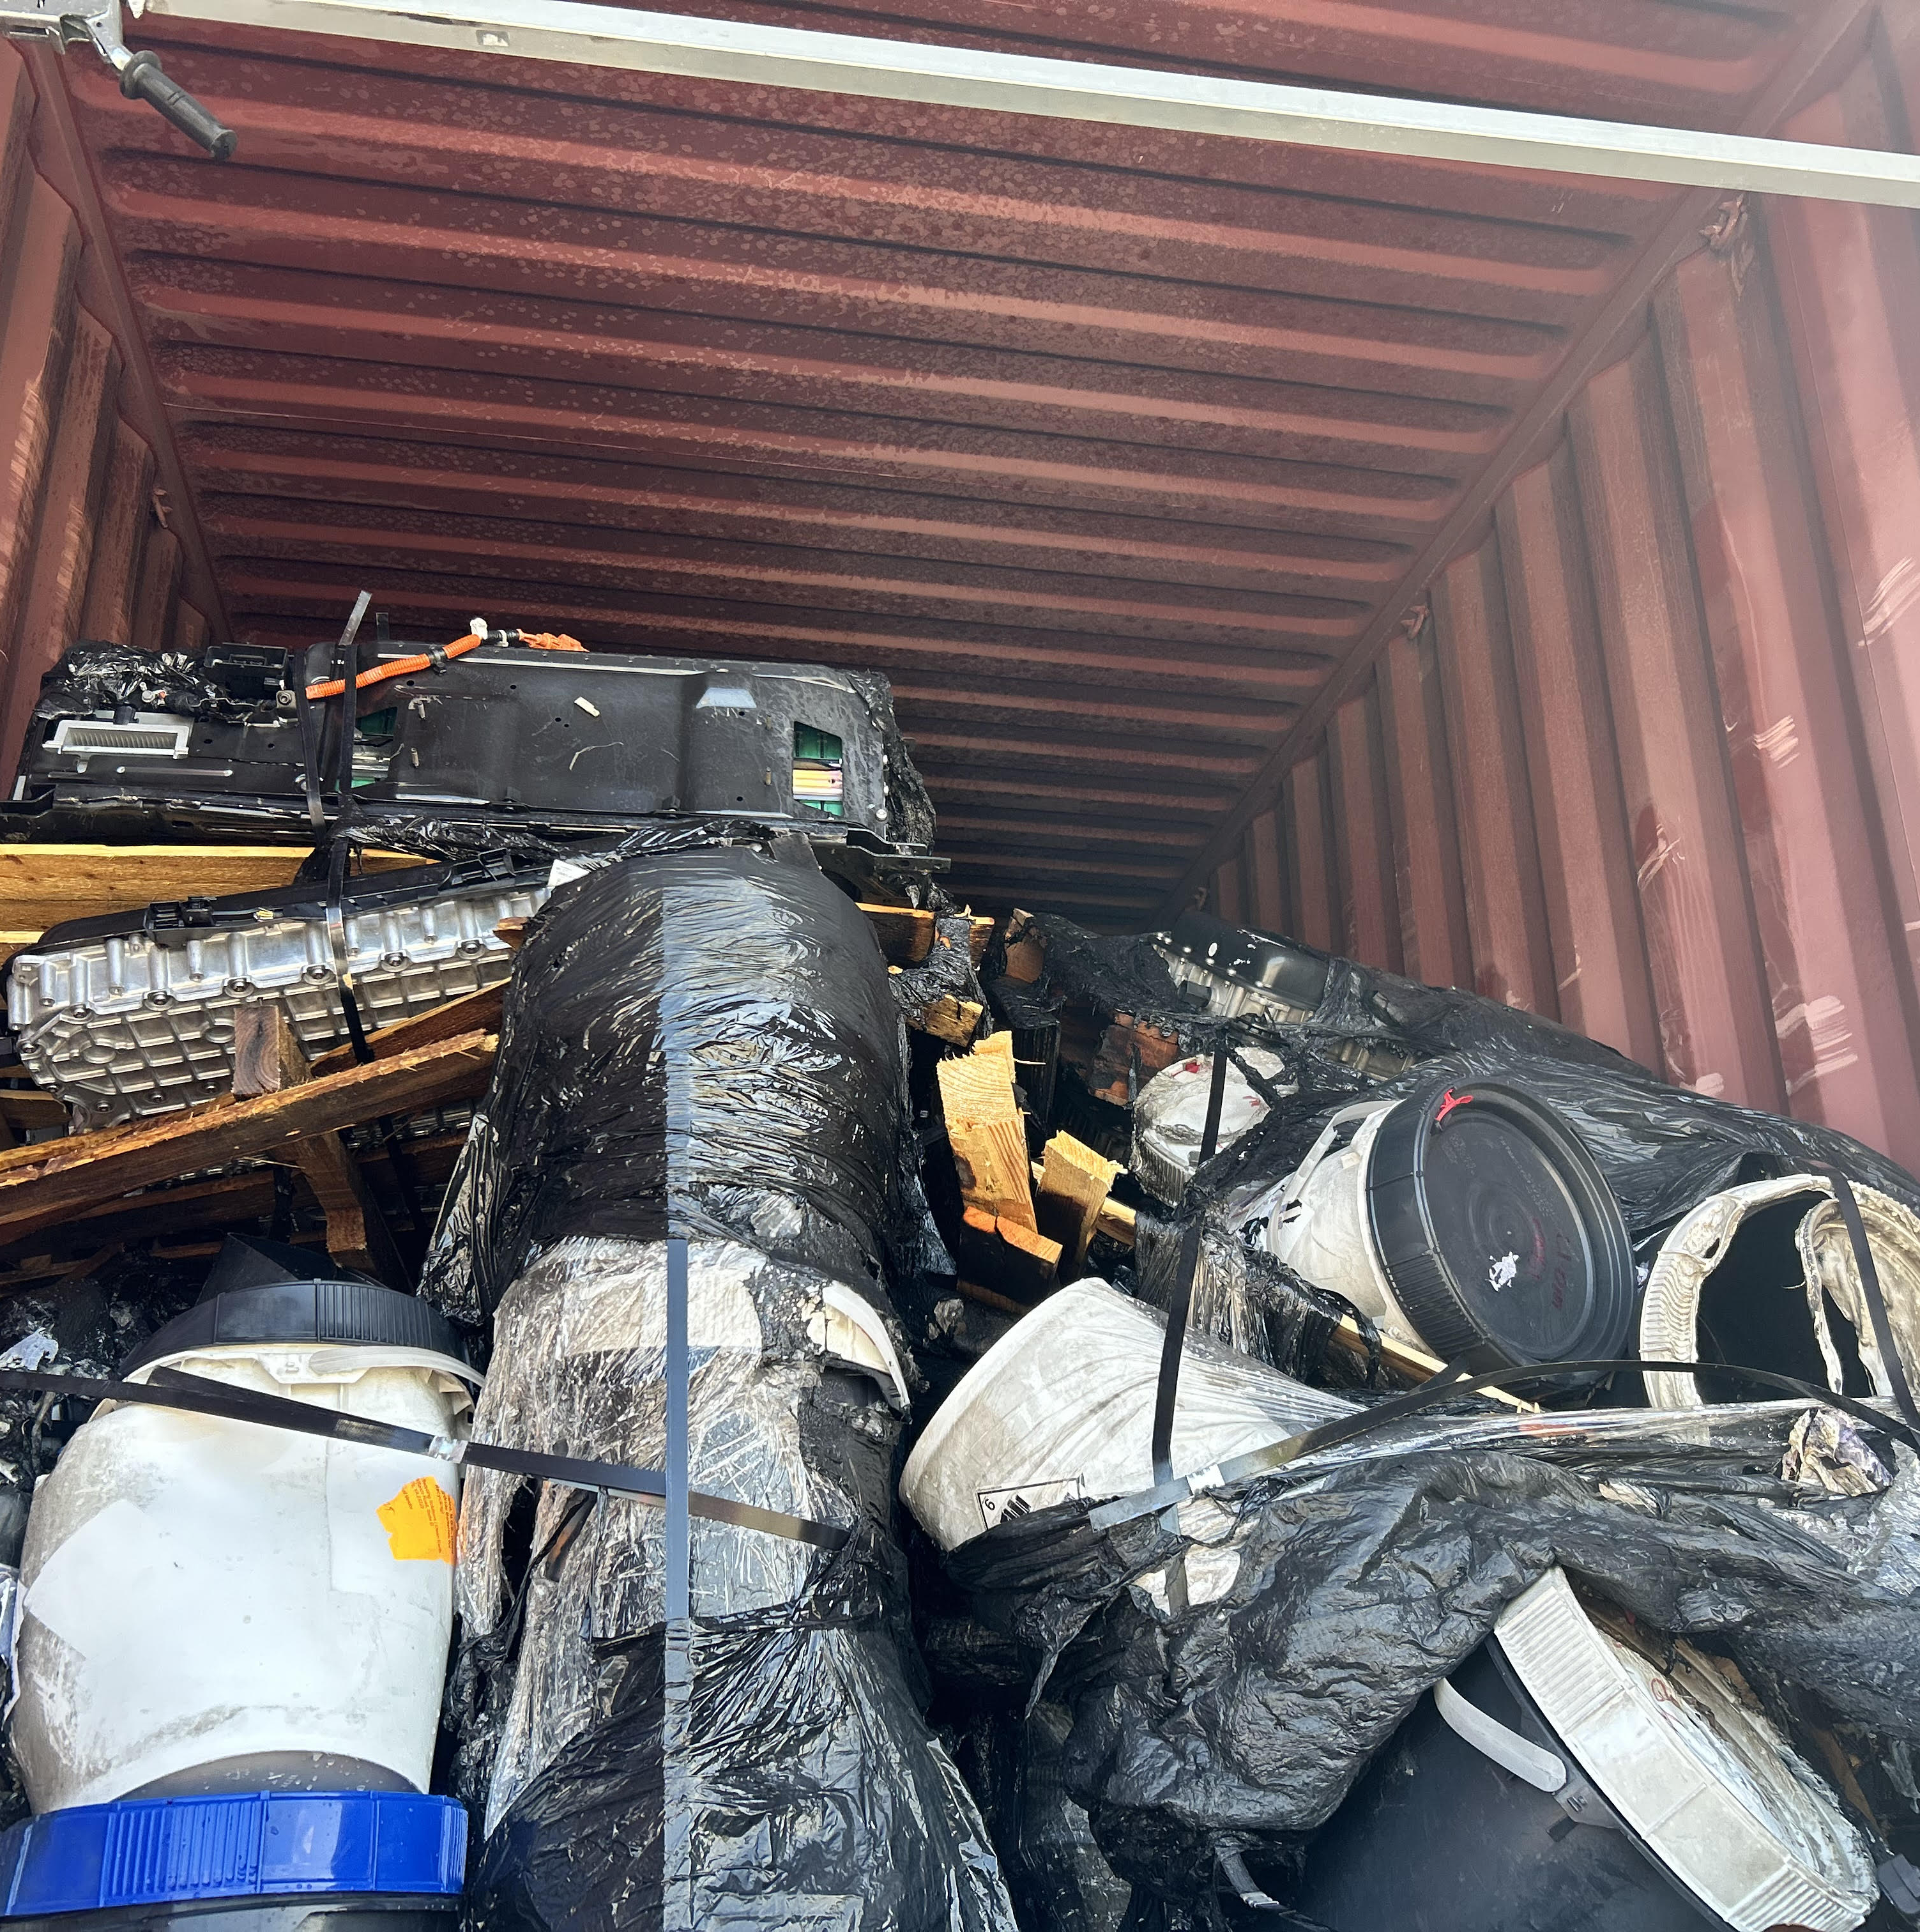
Morris, IL

Slide 25
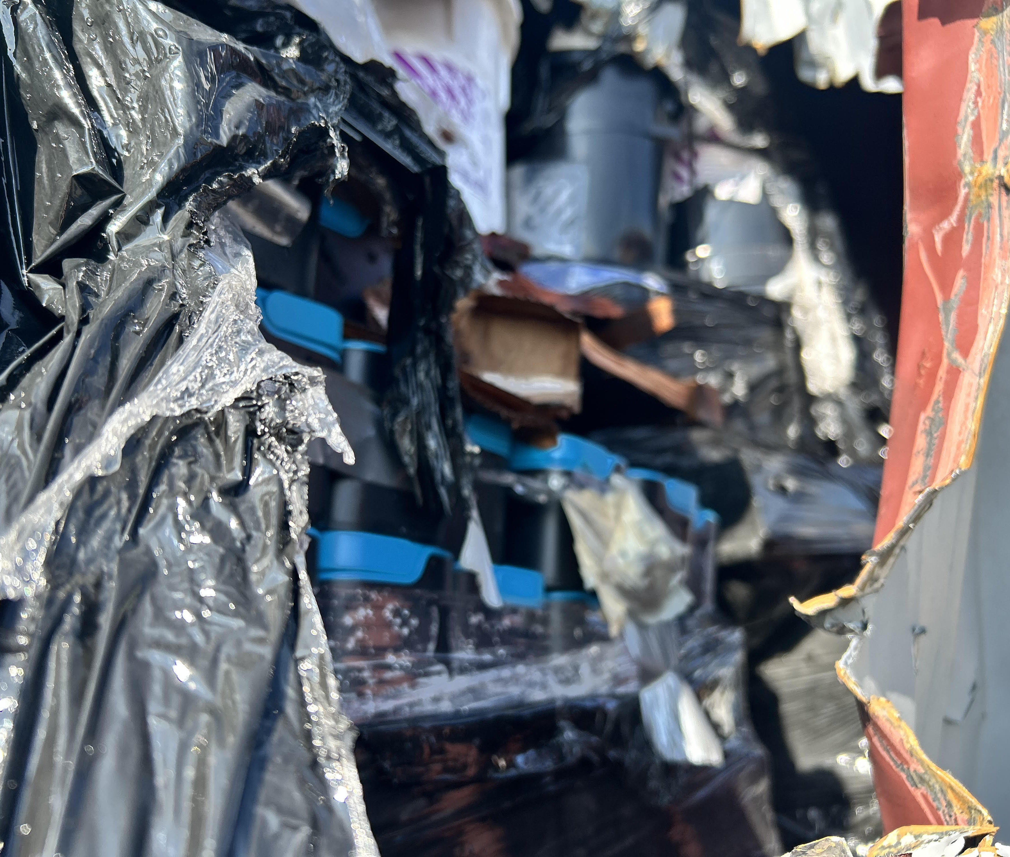
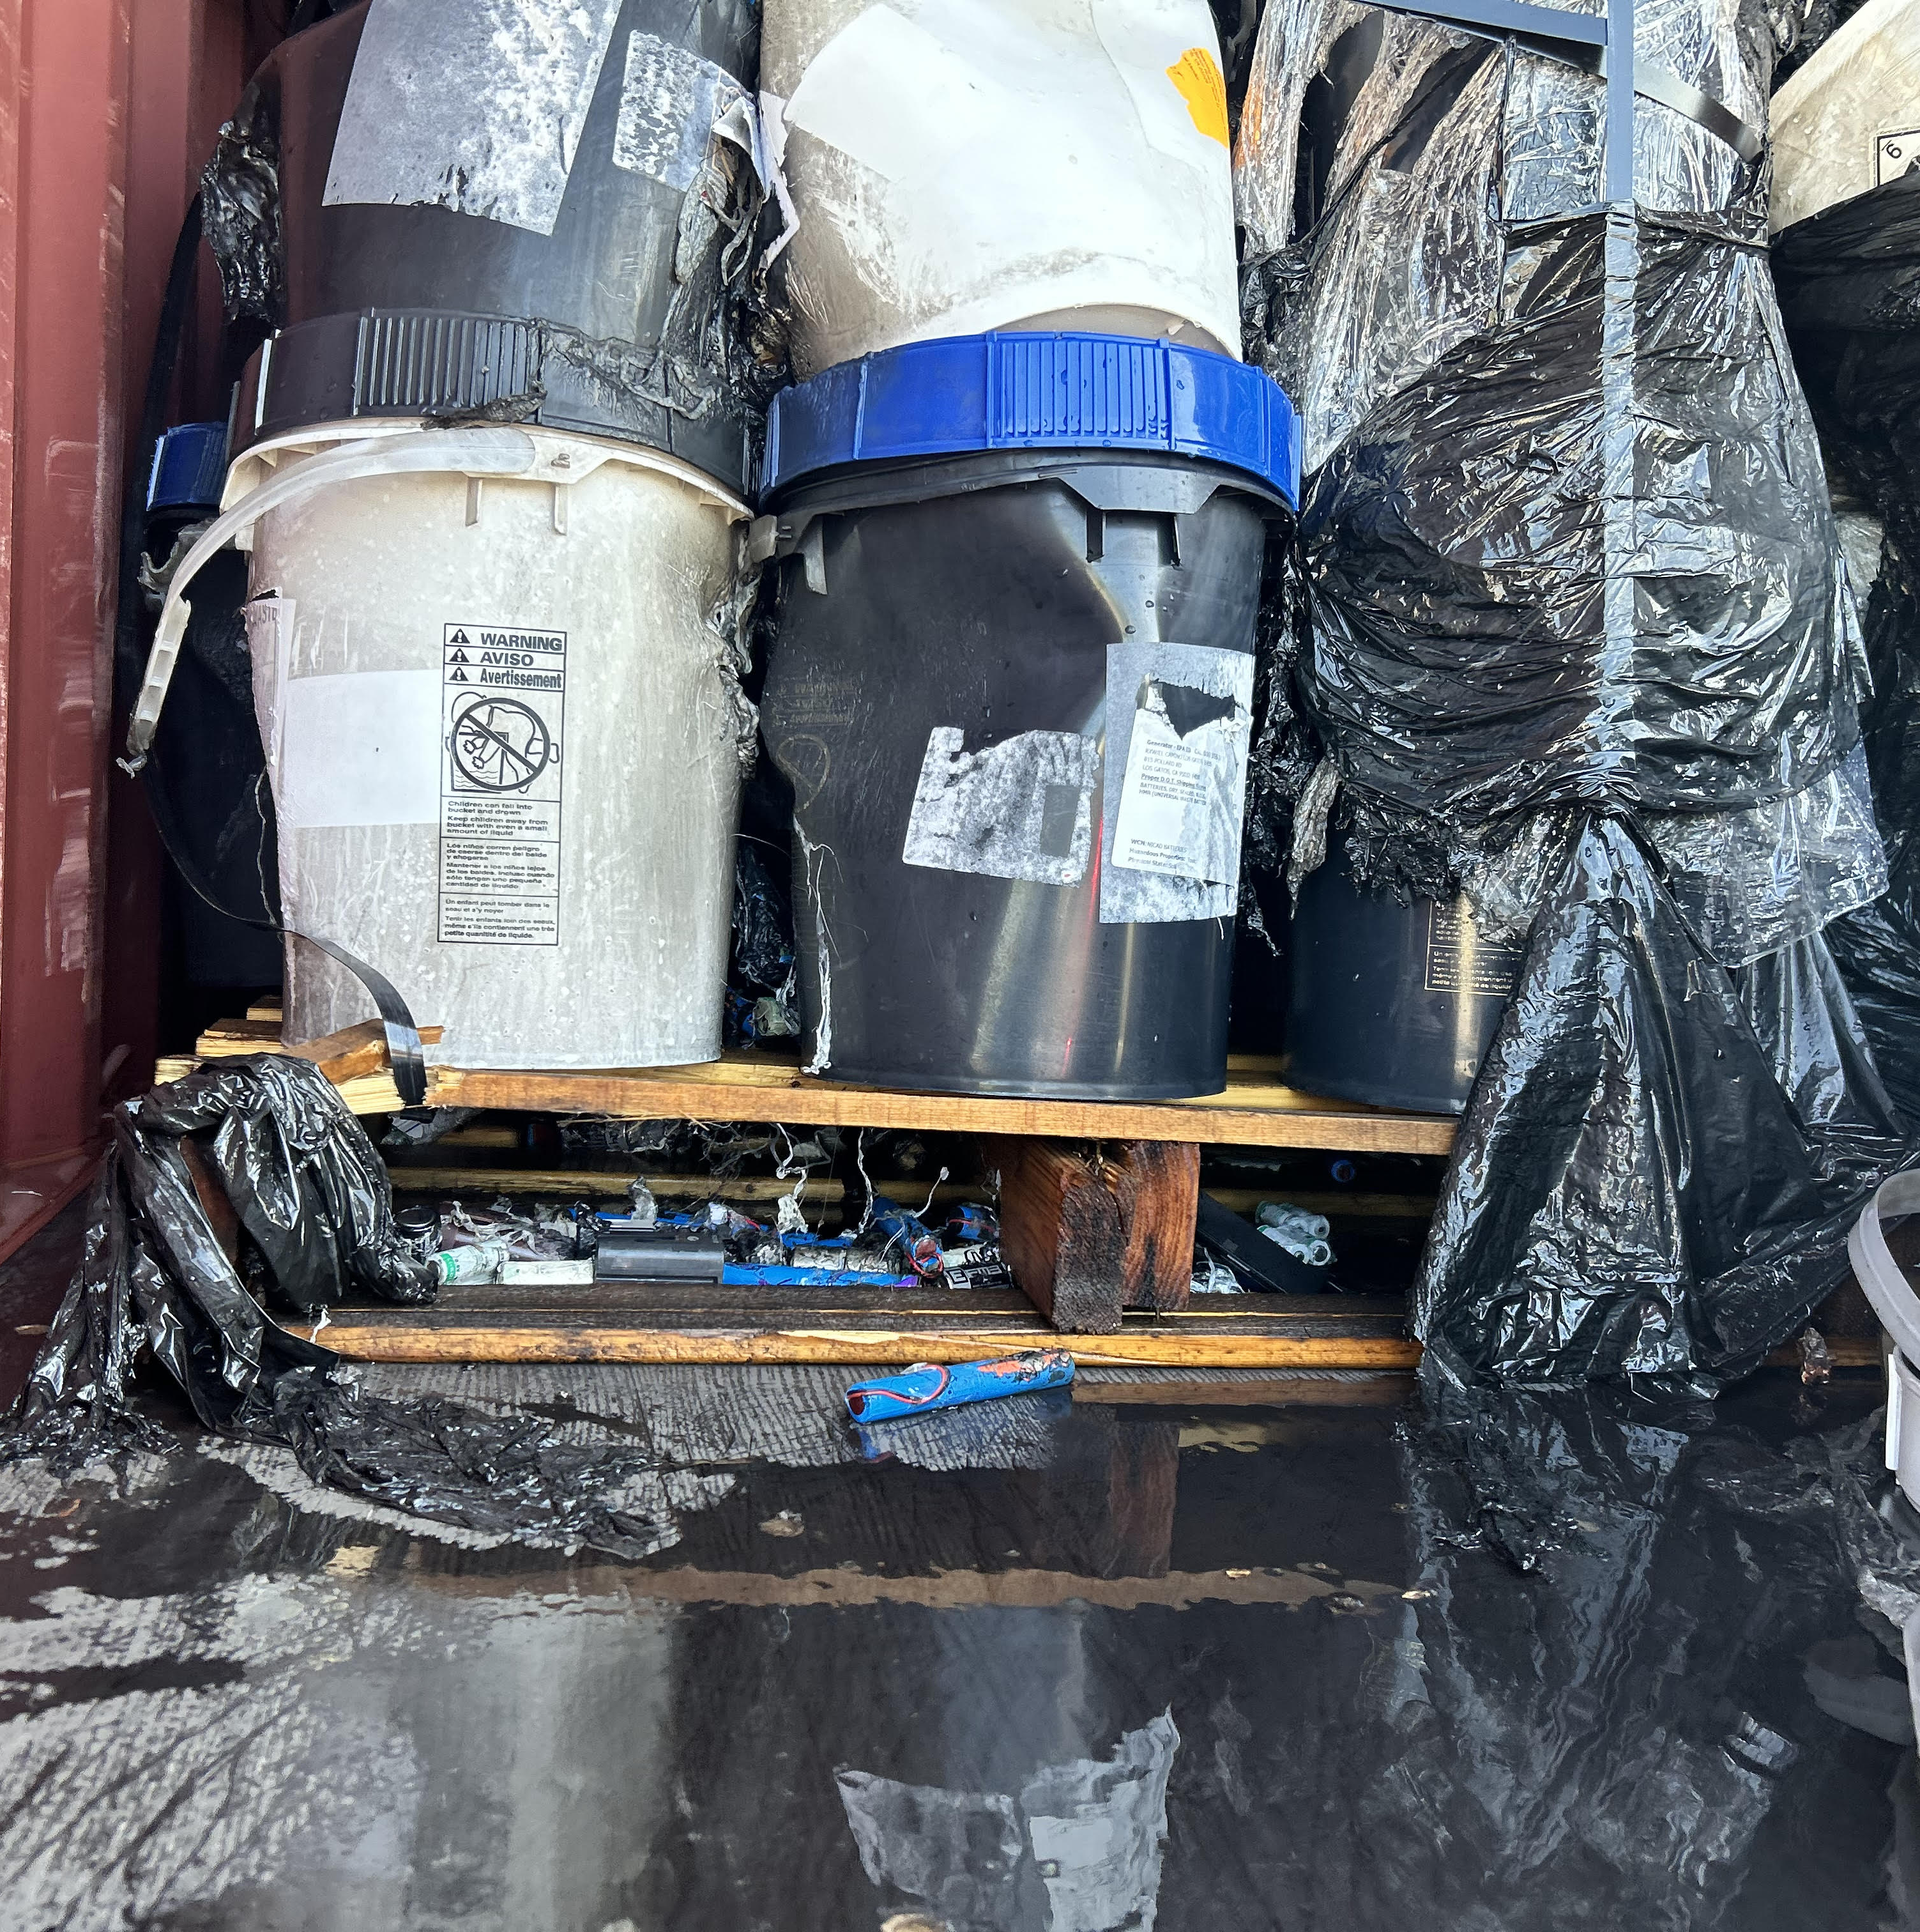
Morris, IL

Slide 26
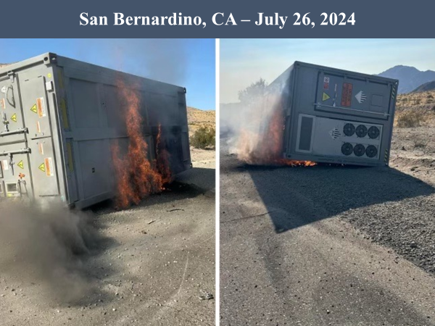
San Bernardino, CA

Slide 27
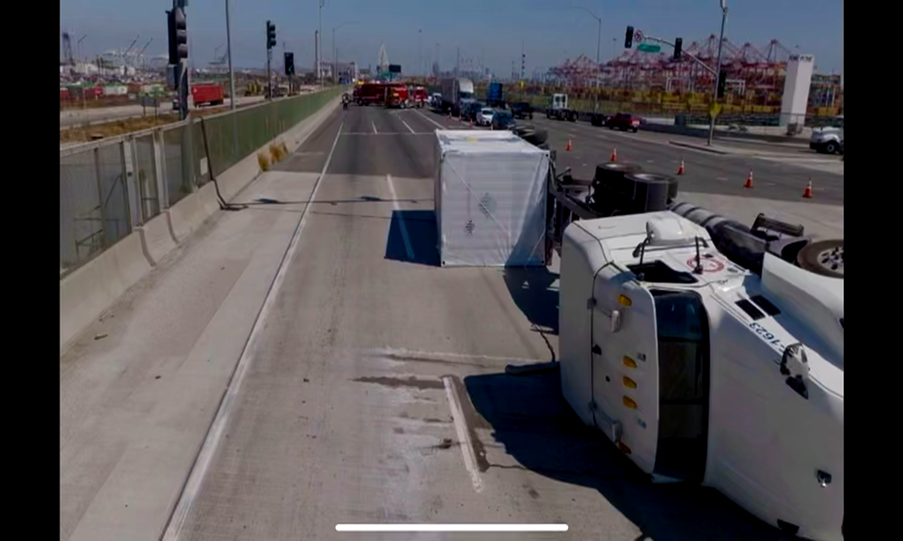
San Pedro, CA

Slide 28
Review
Poor handling in use, collection and storage at end-of-life​.
Poor handling and packaging methods in transportation​.
Frustrated shipping is occurring because there is no way to see damage outside of clear physical evidence.
End of life battery handling by industry is inconsistent.​
High center of gravity for large battery energy storage systems
in transportation.

Slide 29
Emergency Waivers
PHMSA – 2026

Slide 30
Emergency Waivers Topics
What is an Emergency Waiver?
When can an Emergency Waiver be issued?
What information is needed to Issue an Emergency Waiver?
Where should a request for an Emergency Waiver be sent?
Examples of Emergency Waivers

Slide 31
What is an Emergency Waiver?
An order issued by the Administrator of the Pipeline and Hazardous Materials Safety Administration (PHMSA) or their designee to waive all or parts of the Hazardous Materials Regulations (HMR) if a federally declared disaster or emergency exists.
Emergency Waivers have a maximum duration of 60 days from the date they are issued.

Slide 32
What is an Emergency Waiver?
49 USC 5103(c) Federally Declared Disasters and Emergencies.
(1) In general. – The Secretary may by order waive compliance with any part of
an applicable standard prescribed under this chapter without prior notice and comment and on terms the Secretary considers appropriate if the Secretary determines that:
  (A) it is in the public interest to grant the waiver;
  (B) the waiver is not inconsistent with the safety of transporting hazardous materials; and
  (C) the waiver is necessary to facilitate the safe movement of hazardous materials into, from, and within an area of a major disaster or emergency that has been declared under the Robert T. Stafford Disaster Relief and Emergency Assistance Act (42 U.S.C. 5121 et seq.).

Slide 33
What is an Emergency Waiver?
49 USC 5103(c) Federally Declared Disasters and Emergencies.
(2) Period of waiver. – A waiver under this subsection may be issued for a period of not more than 60 days and may be renewed upon application to the Secretary only after notice and an opportunity for a hearing on the waiver. The Secretary shall immediately revoke the waiver if continuation of the waiver would not be consistent with the goals and objectives of this chapter.
(3) Statement of reasons. – The Secretary shall include in any order issued under this section the reasons for granting the waiver.

Slide 34
When can an Emergency Waiver be issued?
When a major disaster or emergency has been declared under the Robert T. Stafford Disaster Relief and Emergency Assistance Act.
It is in the public interest to grant the waiver.
The waiver is consistent with hazardous materials transportation safety.
The waiver is necessary to facilitate the safe movement of hazardous materials into, from, and within an area of the major disaster or emergency.

Slide 35
What information is needed to issue an Emergency Waiver?
Identification of the location of the Emergency.
Identification of the Emergency Declaration.
Identification of the people operating under the terms of the Emergency Waiver
Most often EPA, Coast Guard or another Federal Agency, and
People operating under the direction of those Agencies.
Description of the relief needed.
Timeline the relief is needed, up to 60 days.

Slide 36
Where should a request for an Emergency Waiver be sent?
A request for an Emergency Waiver should be submitted to PHMSA at:
  specialpermits@dot.gov
Copies of the request should also be sent to:
The Associate Administrator of Hazardous Materials Safety
The Assistant Chief Counsel, Hazardous Materials Safety Law
The Division Director, Standards and Rulemaking

Slide 37
Examples of Emergency Waivers
Hurricane Harvey – August 25, 2017 (First Waiver Issued by PHMSA)
Alaska Earthquake – November 30, 2018
Nebraska/Iowa Severe Winter Storms – March 21-23, 2019
New Mexico Wildfires – May 4, 2022

Slide 38
Emergency Special Permits
PHMSA – 2026

Slide 39
Emergency Special Permits Topics
What happens if 60 days is not long enough to complete the
needed operations?
What is an emergency special permit?
When are emergency special permits used for disaster related operations?
What information is needed to issue an emergency special permit?
Where should an application for emergency special permit be sent?

Slide 40
What if 60 days is not long enough?
Often the clean up or other response to a declared disaster area will require more than 60 days to complete.
Renewal of an Emergency Waiver beyond the initial 60-day time period requires public notice and a hearing on the continued need for the waiver.
To date, no Emergency Waivers have been renewed.
Operations may be continued under the terms on an emergency special permit.

Slide 41
What is an emergency special permit?
An emergency special permit is an authorization to conduct an activity that would not be authorized under the terms of the HMR.
A special permit application may be processed on an emergency basis if the special permit is required to prevent significant injury to persons or property (other than the hazardous material to be transported) that could not be prevented if the application were processed on a routine basis.

Slide 42
When are emergency special permits used for disaster-related operations?
Emergency special permits can be used for disaster-related
operations if:
  A Stafford Act declaration has not been made, or
  To authorize activity beyond 60-day time period authorized under an Emergency Waiver.
Emergency special permits are not limited by the 60-day time period of emergency waivers. They can initially be granted for up to 2 years.

Slide 43
What information is needed to issue an emergency special permit?
The information required to be provided in an application for an emergency special permit is found in 49 CFR 107.117 and 107.105.
More information is required in an application for emergency special permit than is required for an Emergency Waiver.

Slide 44
Where should an application for emergency special permit be sent?
An application for emergency special permit should be submitted to:
  specialpermits@dot.gov

Slide 45
Class 9 Subdivisions
PHMSA – 2026

Slide 46
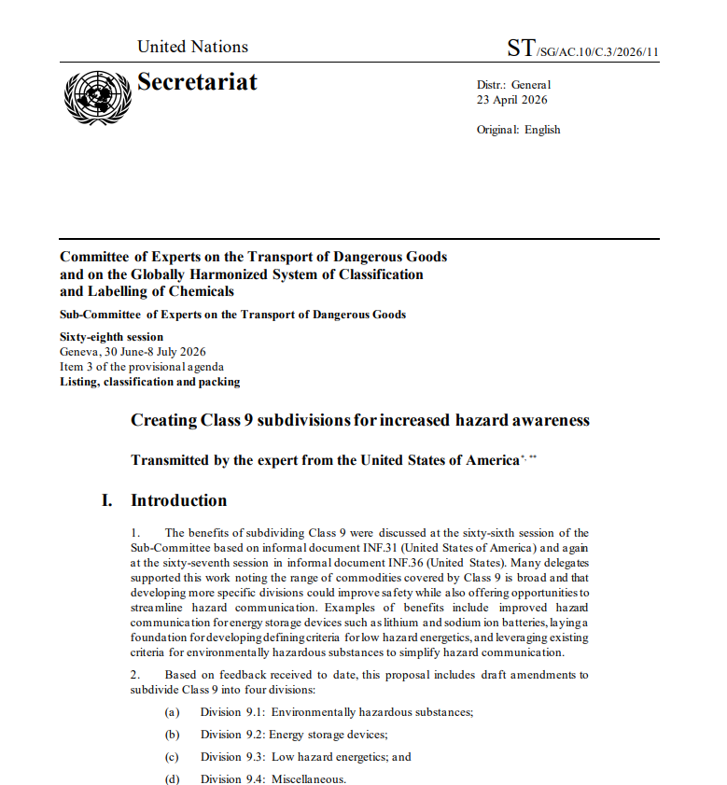

Class 9 Proposed Changes
  U.S. raised the issue at the 66th and 67th UN SCOE TDG sessions held in June and December of 2025.
  The concept was well received globally and new proposal submitted to June 2026 session with regs text.
  Public meeting May 28

Slide 47

Creating Subdivisions for Clarity
Creating Class 9 subdivisions for increased hazard awareness and transport efficiency (USA)
  Proposed new Divisions:
    Environmentally hazardous substances
    Energy storage devices
    Low hazard energetics
    Miscellaneous

Slide 48
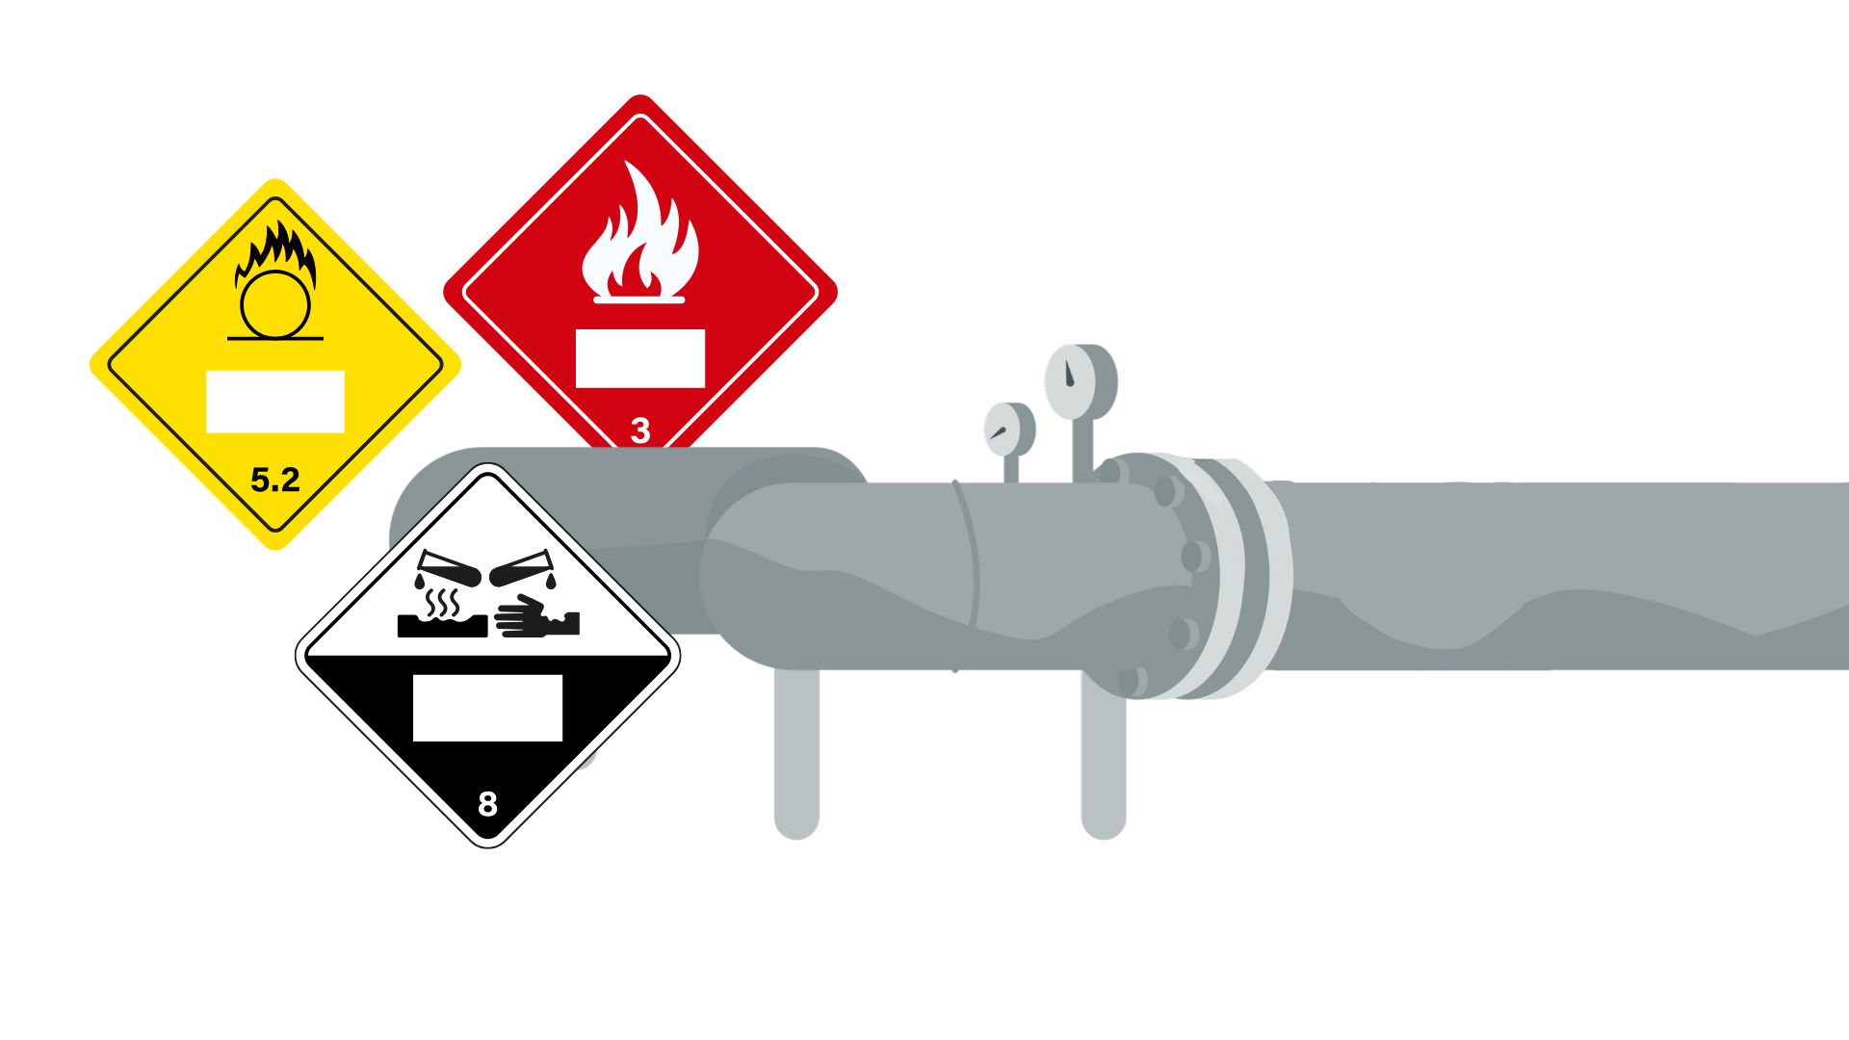
Potential Benefits & Considerations
Division | Objectives | Potential Benefits | Potential Hurdles
9.1 Environmentally Hazardous Materials | Link to established criteria while maintaining flexibility based on existing national systems. | Integration of marine pollutant pictogram in existing Class 9 label as an option | Ensuring no additional burden on users
9.2 Energy Storage Devices | Align with existing criteria and future hazard class working group updates. | Facilitate enhanced hazard communication with modal implementation flexibility | Integration of new hazard-base work and outliers like lithium battery articles
9.3 Low Hazard Energetics | Systematically recognize Class 9 assignments | Facilitates future criteria that maintains existing articles and authority flexibility | Developing criteria
9.4 Other Miscellaneous Dangerous Goods | All other Class 9 materials | No changes envisioned | N/A

Slide 49
PHMSA Resources
PHMSA – 2026

Slide 50


PHMSA resources . . .
Lithium Battery Guide for Shippers
Scenario-based shipping guides based
on battery type, size, and configuration​
Recorded webinar on guide
use available on YouTube
www.phmsa.dot.gov

Slide 51


PHMSA resources . . .
Understanding the Risks of Damaged, Defective, or Recalled (DDR) Lithium Batteries
https://www.phmsa.dot.gov/training/hazmat/understanding-risks-damaged-defective-or-recalled-ddr-lithium-batteries

Slide 52

PHMSA resources . . .
Safety Advisory Notice for the Transportation of Lithium Batteries for Disposal or Recycling
https://www.phmsa.dot.gov/sites/phmsa.dot.gov/
files/2022-05/Final-5-16-Lithium-Battery-
Recycling-Safety-Advisory.pdf

Slide 53
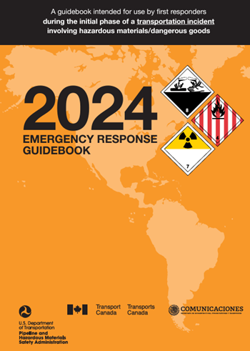

PHMSA resources . . .
Emergency Response Guidebook (ERG) 2024
Key additions in 2024:
Updated Guide 147 with latest recommendations for Lithium- Ion battery fire response
New “Considerations for Lithium Ion Battery and
Electric Vehicle (EV) Fires”
https://www.phmsa.
dot.gov/training/haz
mat/erg/emergency-response-guidebook-erg

Slide 54
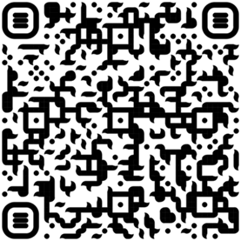
PHMSA resources . . .
Emergency Response Roundtable
Discussion topics include:
  Affirming 2025 Priorities
  Need for Better Quality Data
  Broader Public Engagement
  Fill Hazmat Response Program Gaps
Next Roundtable scheduled for June 2-3, 2026
Roundtable reports and webinar available on PHMSA website.

Slide 55

Questions?
Hazardous Matters is PHMSA's quarterly newsletter for hazardous materials safety. Every quarter, this publication consolidates timely information on our latest rulemaking activities, upcoming workshops and webinars, newest publications, and other highlights from PHMSA's current safety initiatives.

Slide 56
Presenter Contact Information
Today’s Presenter:
Eddie Murphy, Emergency Response Liaison
202.734.9122 (Cell) | Eddie.murphy@dot.gov
Additional Resources:
PHMSA Accident Investigation Team​
HM_Accident_Investigation@dot.gov​

Slide 57
Thank you

